Slide 1
Processing for optical communication devices
In Corial 210IL

Slide 2
Device structure
PR
PR
PR
PR
SiO₂
Cr
Ge-doped SiO₂
quartz wafer
quartz wafer

Slide 3
Process solution Thin SiO₂ film etching

Slide 4
Sample structure
SiO₂ Etching Process
Thin SiO₂ film etching for channel patterning with
6 µm x 6 µm feature size
PR 0.5 µm
PR 0.5 µm
PR
PR
SiO₂ 0.15 µm – 0.3 µm
Cr 0.15 µm – 0.3 µm
Ge-doped SiO₂ 7 µm
6’’ quartz wafer
quartz wafer

Slide 5
Process requirements
SiO₂ Etching Process
Use of C₄F₈ chemistry
Minimum CD loss
No damage to underlayer and wafer
No striation of the sidewalls
No trenching
Careful control of etch selectivity
Etch-stop on Cr layer
Vertical profile (etch slope > 87°)
Targeted process performances
Process | Etch rate nm/min | Selectivity vs. PR
RIE | 45 | > 2

Slide 6
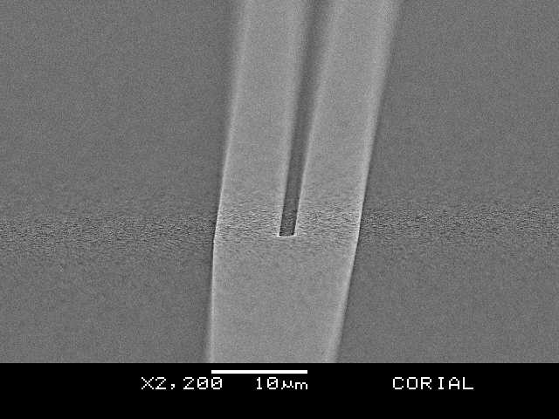
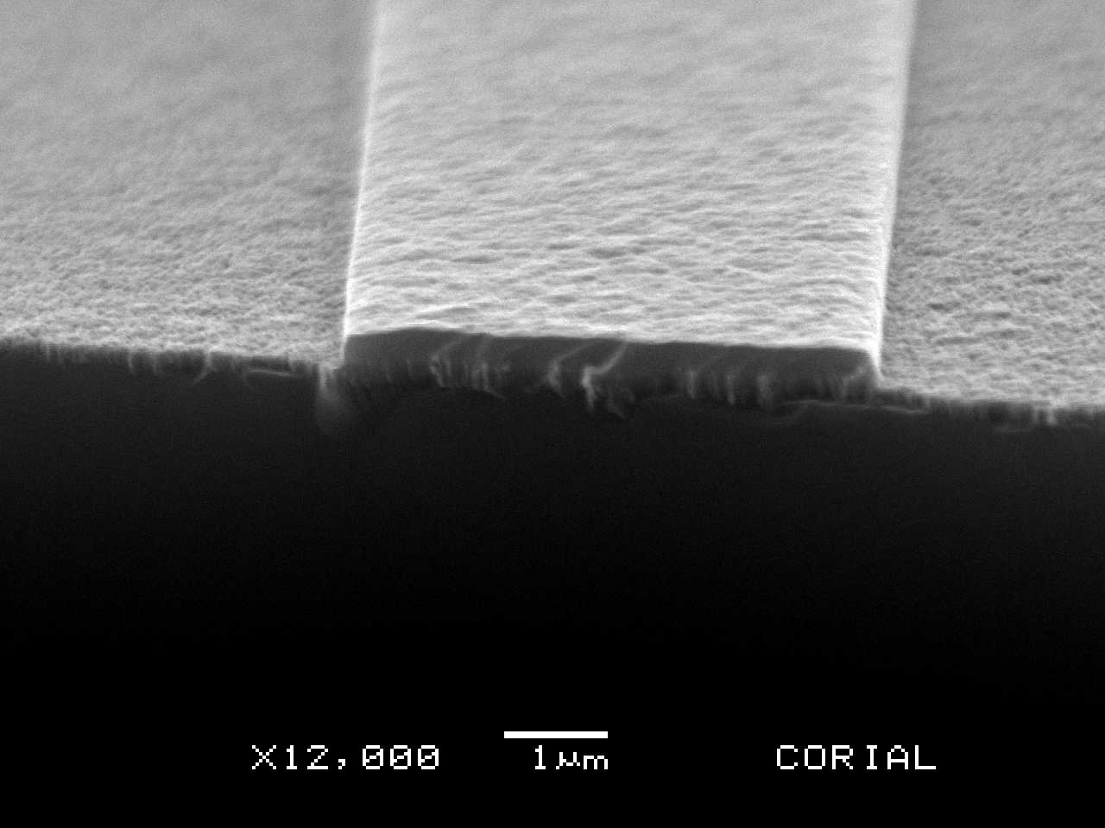
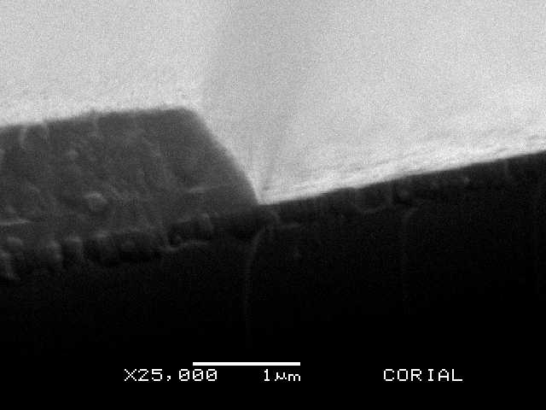
Corial process solution
SiO₂ Etching Process
Process steps
Mask pattern before etching
Process tuning in RIE mode with wafer fragments
RIE etching on full wafers
1
2
3
SiO₂
PR
Cr
SiO₂
Cr
Quartz substrate
PR stripped by O₂ plasma
Slightly positive profile of PR
No trenching or damage
Vertical profile
Rough surface of Cr revealed
Clean etching
Sharp corners

Slide 7
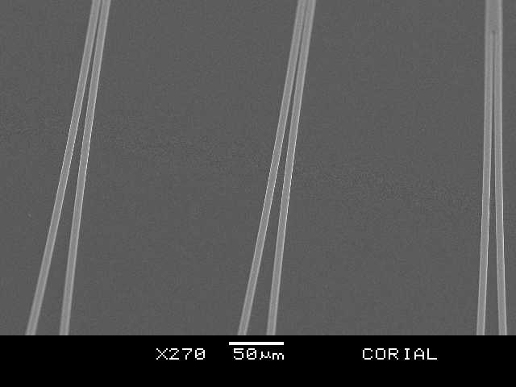
Corial process solution
SiO₂ Etching Process
RIE process performances on 6’’ wafer
Process | Chemistry | Mask | Selectivity to mask | Etch profile | Etch rate (nm/min)
SiO₂ etching | C₄F₈ & O₂ | PR | 2.02 | 87° | 49
C₄F₈ / O₂ gas mixture
Etching time and overetching duration controlled automatically by laser EPD
No trenching by the SEM
Uniform landing all over the wafer (uniformity < 2%) and etch stop on Cr underlayer

Slide 8
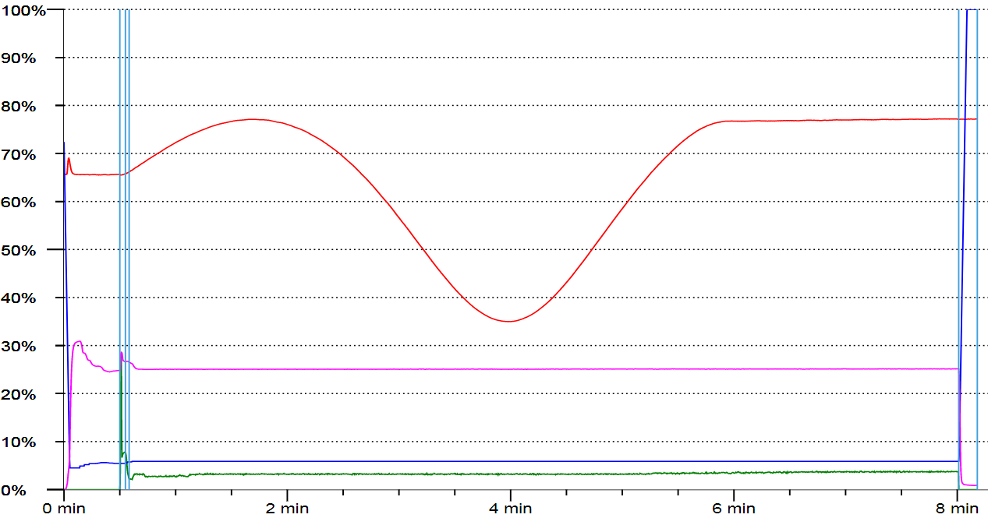
Corial process solution
SiO₂ Etching Process
Process control by laser interferometry
Cr surface is reached
SiO₂ etching
Overetch
Red curve shows the EPD signal

Slide 9
Process solution SiO₂/GeO₂ film etching

Slide 10
Sample structure
SiO₂ /GeO₂ Etching Process
Deep Ge-doped SiO₂ film etching with SiO₂ & Cr mask
SiO2
Cr
Ge-doped SiO2
quartz wafer
quartz wafer

Slide 11
Process requirements
SiO₂ /GeO₂ Etching Process
High etching uniformity at ± 3%
High etch rate
Process ready for mass production
Minimum CD loss
No damage to wafer
No striation of the sidewalls
No trenching
Careful control of etch selectivity
Vertical profile (etch slope 88.5~91.5°)
Targeted process performances
Process | Etch rate nm/min | Selectivity vs. mask
ICP-RIE | 550-600 | > 15:1

Slide 12
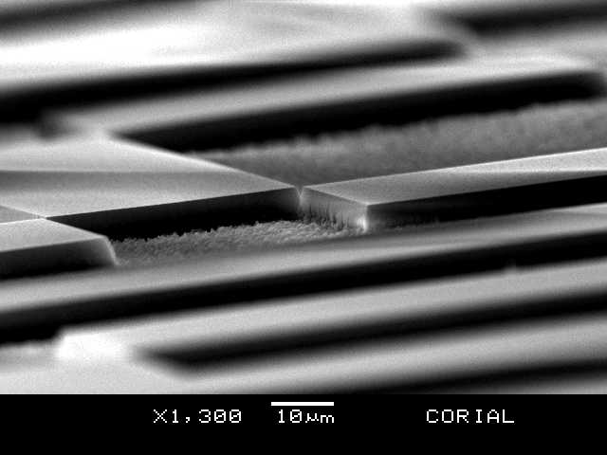
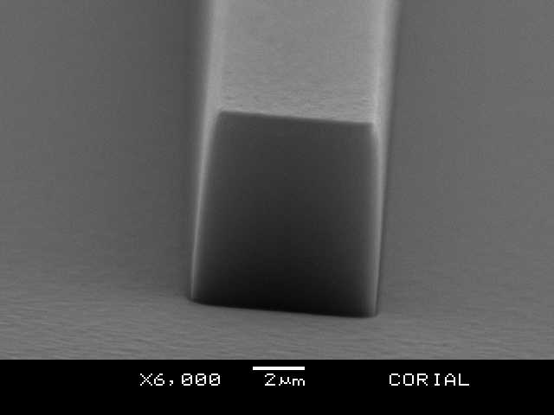
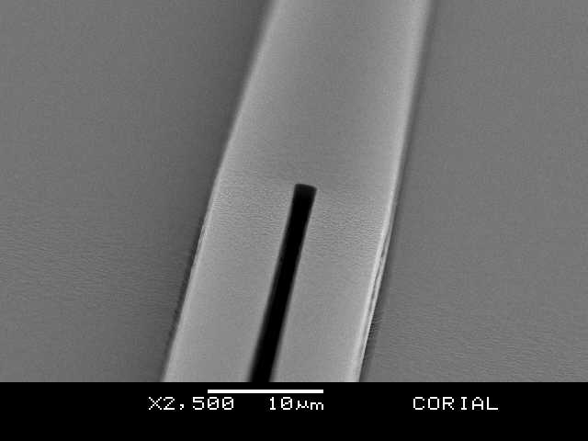
Corial process solution
SiO₂ /GeO₂ Etching Process
Process steps
Mask pattern before etching
Process tuning in ICP-RIE mode with wafer fragments
ICP-RIE etching on full wafers
1
2
3
SiO₂ & Cr mask
Vertical etching profile
Clean bottom
No trenching, smooth sidewalls
Smooth bottom
Vertical walls

Slide 13
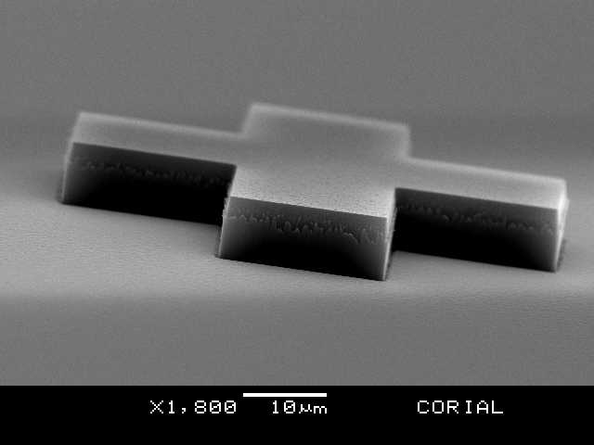
Corial process solution
SiO₂ /GeO₂ Etching Process
ICP-RIE process performances on 6’’ wafer
Process | Chemistry | Mask | Selectivity to mask | Etch profile | Etch rate (nm/min) | Uniformity
SiO₂/GeO₂ etching | C₄F₈ & O₂ | Cr & SiO₂ | > 25 | > 85° | 685 | 1.44
Deep etching of SiO₂/GeO₂ with etch depth of 7 µm
In-situ process control by EPD
No trenching
No damage to wafer

Slide 14
System description corial 210IL

Slide 15
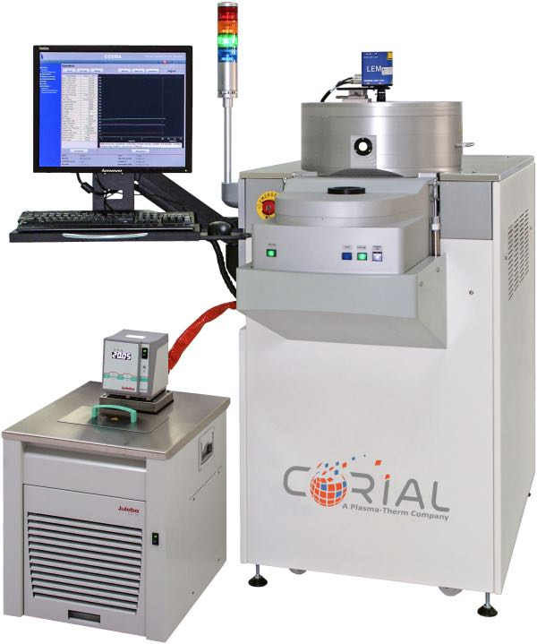
Corial equipment
Corial 210IL
This machine can be operated in both RIE and ICP-RIE modes.
For up to 200 mm substrates,
Compact footprint,
High power (2 KW) ICP source producing uniform high density plasma,
High power (1 KW) RF source to ensure high etch rates,
Shuttles for efficient adaptation of the tool to different wafer sizes, and soft wafer clamping in ICP-RIE mode,
Quartz liner for fast ICPRIE etching with polymerizing chemistries,
Laser end point detector for measurement of the etching rate and determination of stop-etch point.

Slide 16
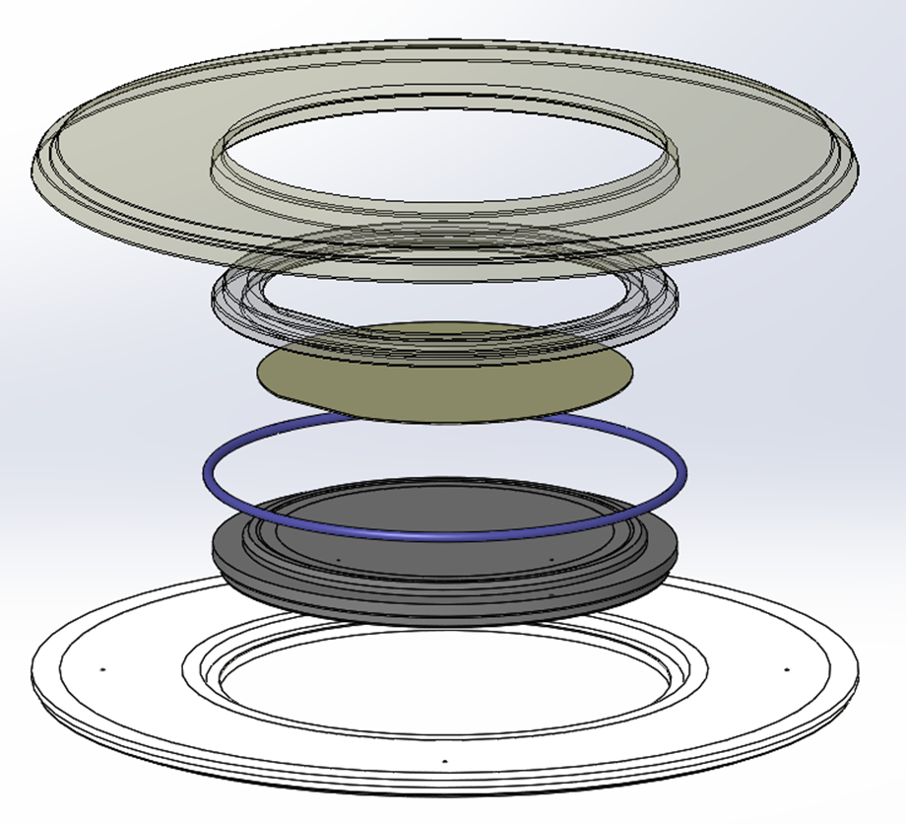
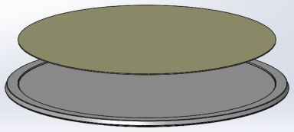
Shuttle holding approach
Corial 210IL
Shuttle NQ200
Shuttle WF100
Guaranteed no wafer damage due to SOFT wafer clamping

