Slide 1
SiC processing
In Corial 200 series

Slide 2
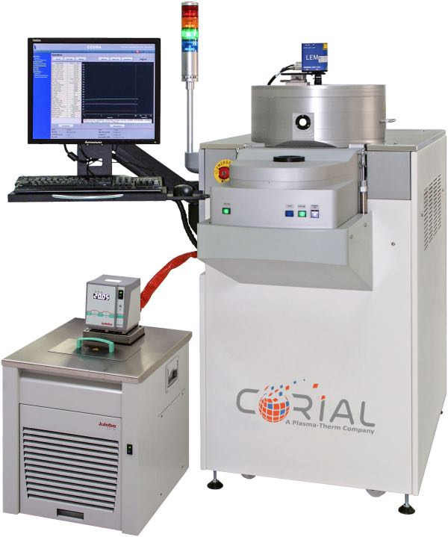
Corial solution for SiC processing
200 mm Platform
Single-wafer and batch-loading equipment
Best-in-class uniformity and process repeatability
Flexibility and scalability of equipment
Dedicated processes for RF devices, MEMS, power devices…

Slide 3
Process solution SiC etch

Slide 4
SiC via etch process
With Ni Mask
> 1400 NM/MIN
ETCH RATE
> 20 SELECTIVITY TO Ni MASK
SMOOTH
SIDEWALLS
> 100 µm ETCH DEPTH
± 3 %
UNIFORMITY
ANISOTROPIC ETCH PROFILE

Slide 5
Low damage sic etch process
For Power Electronics
700 NM/MIN
ETCH RATE
NO TRENCHING
2.5 SELECTIVITY TO SiO2 MASK
87° PROFILE ANGLE
2.5 µm ETCH DEPTH
SLIGHTLY ISOTROPE ETCH PROFILE WITHOUT CLAMPING
1:1
ASPECT RATIO

Slide 6
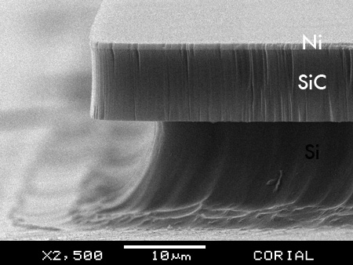
SiC etch process with Ni mask
For MEMS
800 NM/MIN
ETCH RATE
2 µm ETCH DEPTH
85° PROFILE ANGLE
> 25 SELECTIVITY TO Ni MASK
SMOOTH SURFACE

Slide 7
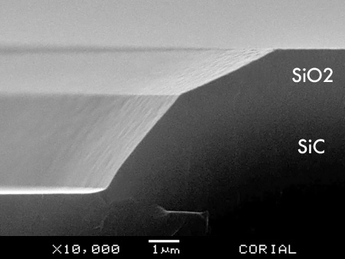
Tapered Sic etch process
For Power Electronics
250 NM/MIN
ETCH RATE
2
SELECTIVITY TO SiO2 MASK
50° PROFILE ANGLE
2.5 µm ETCH DEPTH
TAPERED ETCH PROFILES
LOW ROUGHNESS

Slide 8
System description Corial 210IL

Slide 9
Corial equipment
Corial 210IL
This machine can be operated in both RIE and ICP-RIE modes.
For up to 200 mm substrates,
Hot quartz liners for protection of ICP reactor walls from non-volatile contamination,
High power (2 KW) ICP source producing uniform high density plasma,
High power (1 KW) RF source to ensure high etch rates,
Shuttles for efficient adaptation of the tool to different wafer sizes, and soft wafer clamping in ICP-RIE mode,
Very high conductance pumping system Adixen ATH1600M,
Helium pressure to ensure the thermal transfer between the cathode, the substrate holder and the substrates,
Laser end point detector for measurement of the etching rate and determination of stop-etch point.

Slide 10
Process solution SiC deposition

Slide 11
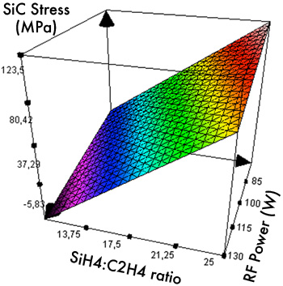
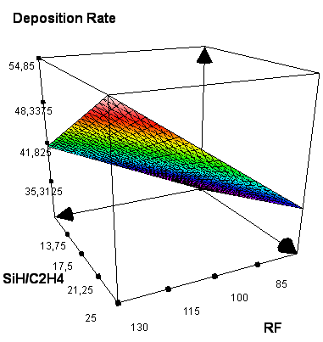
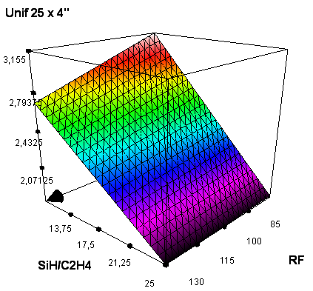
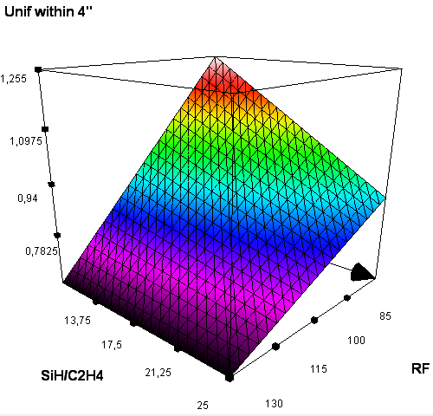
SiC deposition process
High Deposition Rates
Process | Deposition Rate (nm/min) | Refractive Index | Stress (MPa) | WIW Uniformity on 8” wafer (D250) | WIW Uniformity on 4” wafer (D500) | WTW Uniformity on 25 x 4” wafers (D500)
SiC PECVD deposition | 20 to 150 | 2.6 to 3.0 | -100 to +100 | < ± 3% | < ± 1% | < ± 3%

Slide 12
System description corial D250

Slide 13
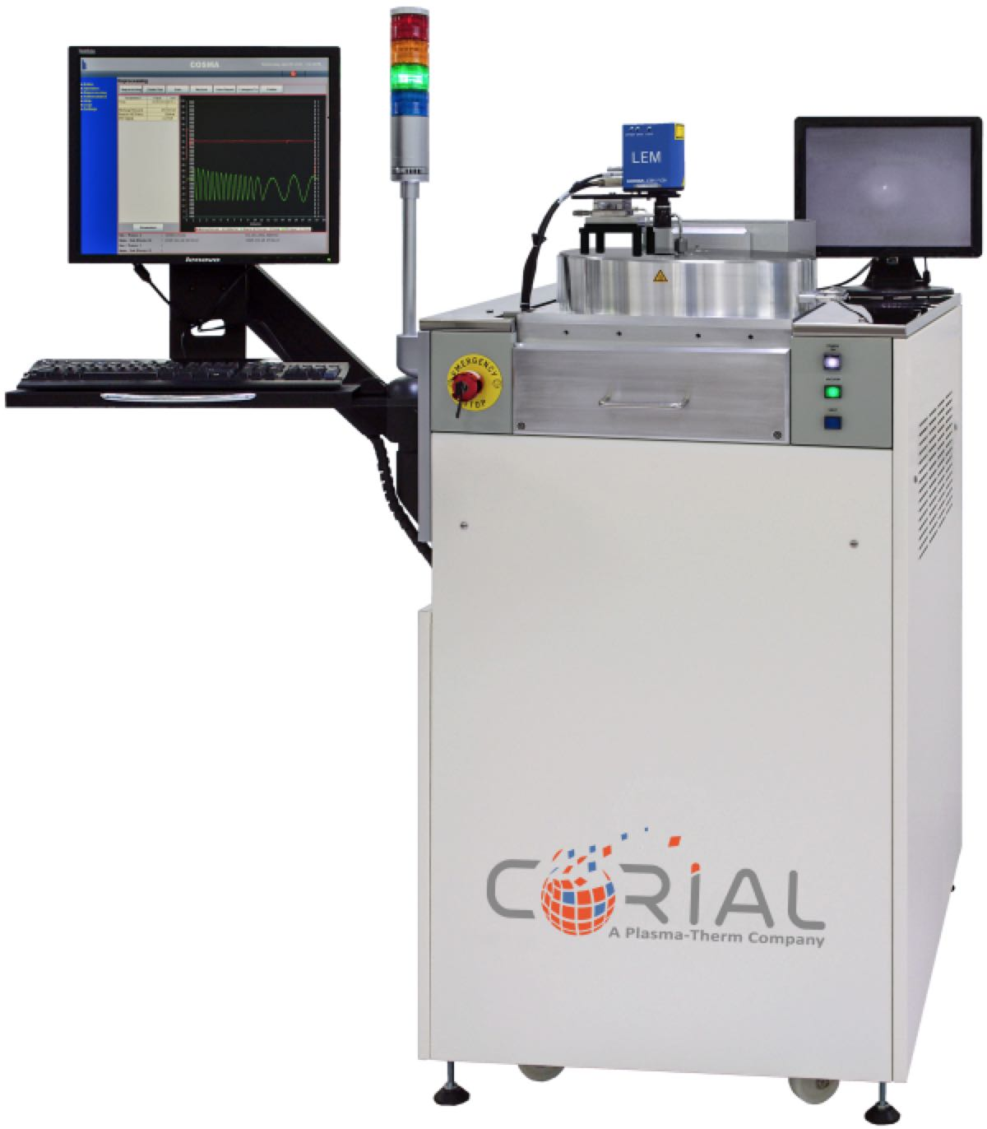
Corial equipment
Corial D250
This machine can be operated in PECVD mode.
For up to 200 mm substrates,
Compact footprint,
Uniformly heated pressurized rector design for high uniformity of thickness and deposited film properties,
Film stress control with a single RF frequency,
Efficient plasma cleaning allowing to eliminate manual cleaning,
Laser end point detector for in-situ film thickness control.

