Slide 1
SiC trench etch for MOSFET application
In Corial 210IL

Slide 2
Device structure
SiC MOSFET Structure
SiC substrate
1.8 - 2 um
PR mask
trench etch
2 - 2.3 um
SiO2
2.5 um
SiC wafer
SiC wafer
362 um
362 um

Slide 3
Process solution SiC trench etch for mosfet application

Slide 4
Sample structure
SiC MOSFET Structure
SiC substrate
1.8 - 2 um
PR mask
trench etch
2 - 2.3 um
SiO2
2.5 um
SiC wafer
SiC wafer
362 um
362 um

Slide 5
Process requirements
SiC Trench Etch
High etch rate
Throughput is key as volume production is required
Target is 400 nm/min
Low damage
To avoid reduction of device lifetime
Reproducibility of feature dimensions
No CD loss
Vertical profile with round shape at the bottom of the patterns

Slide 6
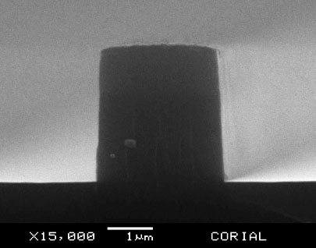
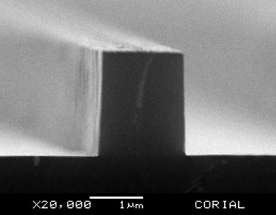
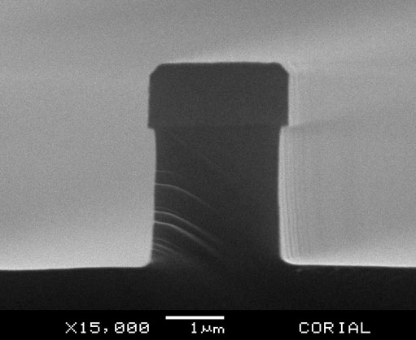
CORIAl process solution
SiC Trench Etch
CORIAL process steps
PR pattern before SiO2 etching
SiO2 pattern after etching
SiO2 pattern after stripping
Optimized SiC etching
1
2
3
4
PR thickness 1.8 um with tapered profile and 80° angle
SiO2 thickness 2.2 um
Vertical profile
89°
vertical profile with round shape at the bottom of the patterns

Slide 7
CORIAl process solution
SiC Trench Etch
CORIAL process performances for SiO2 mask etch
Process steps | Mask | Selectivity to mask | Etch profile (°) | Etch rate (nm/min) | Etch depth (um)
SiO2 mask etching | PR | 2.5 | 89 | 60 | 2.2
SiO2 etching displays vertical profile

Slide 8
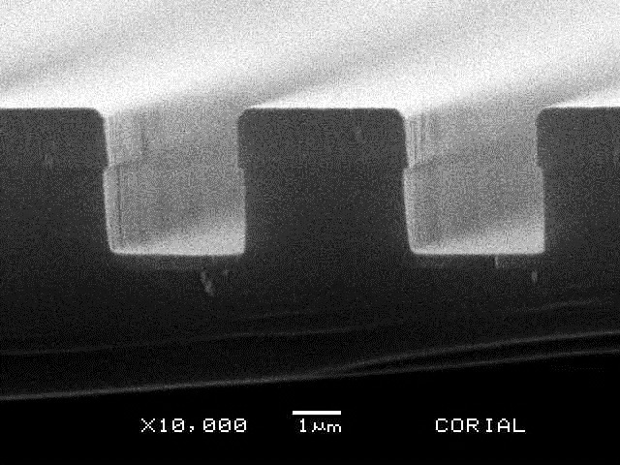
CORIAl process solution
SiC Trench Etch
CORIAL process performances for SiC trench etch
Process steps | Mask | Selectivity to mask | Etch profile (°) | Etch rate (nm/min) | Etch depth (um)
SiC trench etch | SiO2 | 2.6 | 89 | 730 | 2.5
High selectivity versus the SiO2 mask: SiO2 etch rate is
280 nm/min and SiC etch rate is 730 nm/min
The SiC etching is slightly isotropic giving rise to vertical profile with round shape at the bottom of the patterns.
The process can be applied to etching of narrow trenches for SiC MOSFET application

Slide 9
System description Corial 210IL

Slide 10
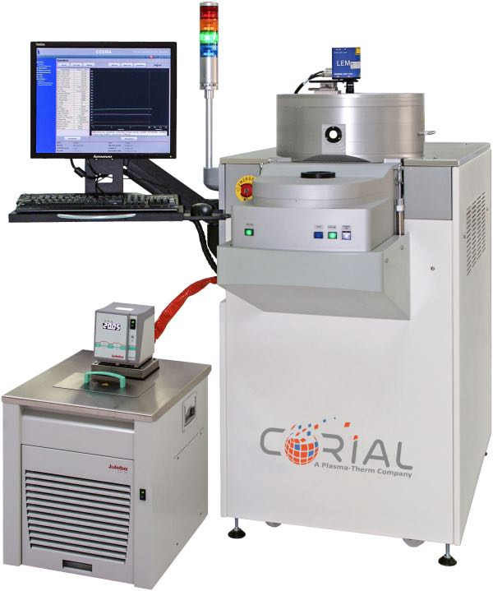
Corial equipment
Corial 210IL
This machine can be operated in both RIE and ICP-RIE modes.
For up to 200 mm substrates,
Fast etch rate with 2 KW ICP source and 0.6 KW RF biasing,
Shuttles for efficient adaptation of the tool to different wafer sizes, and soft wafer clamping in ICP-RIE mode,
Loadlock for stable and repeatable process conditions and for higher throughput,
High reproducibility with top gas shower providing uniform gas distribution and cathode with uniform He distribution,
95% uptime,
Laser end point detector for measurement of the etching rate and determination of stop-etch point.

