Slide 1
SiN processing for MEMS type probe card
In Corial 200 series

Slide 2
Device structure
PR
PR
SiN (1 um)
SiN (1 um)
SiN (1 um)
Cr pads
Cr pads
quartz wafer
quartz wafer

Slide 3
Process solution sin deposition

Slide 4
Sample structure
SiN Deposition Process
4” Quartz wafer patterned with Cr pads
SiN (1 um)
Cr pads (1000 Å)
Cr pads(1000 Å)
4’’ quartz wafer (500 um)
4’’ quartz wafer (500 um)

Slide 5
Process requirements
SiN Deposition Process
High reproducibility
Run to run ± 5%
High thickness uniformity
± 3% on sample
High thickness accuracy
1 um ± 5%
Targeted process performances
Process | Deposition rate nm/min | Stress MPa | BOE etch rate nm/min
PECVD | 100 | < +/- 250 | < 100

Slide 6
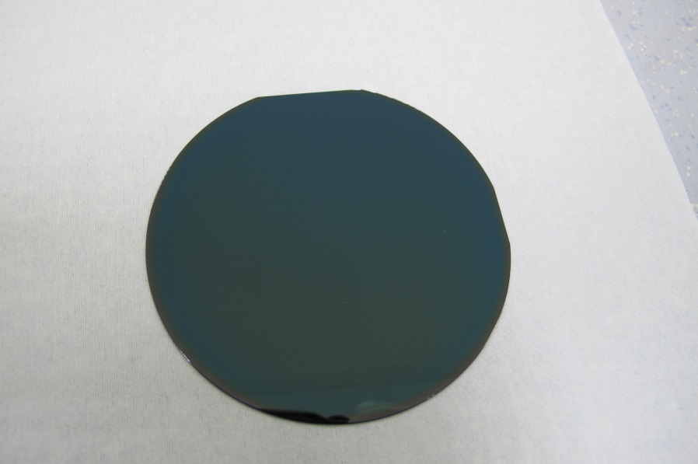
Corial process solution
SiN Deposition Process
CORIAL PECVD process performances on 4’’ wafer
Process | Chemistry | Deposition rate nm/min | BOE rate nm/min | Stress MPa | Refractive index | Thickness non uniformity | Uniformity WIW | Uniformity Run to Run
1 um SiN deposition | SiH₄, NH₃ & N₂ | > 100 | 72 | -299 +/- 50 | 1.98 +/- 0.01 | 0.1% | 0.96% | 0.38%
Process conditions: 250°C, Pressure 1000 mTorr, Ar 230 sccm, N₂ 200 sccm, NH₃ 150 sccm, SiH₄
In-situ process control by EPD

Slide 7
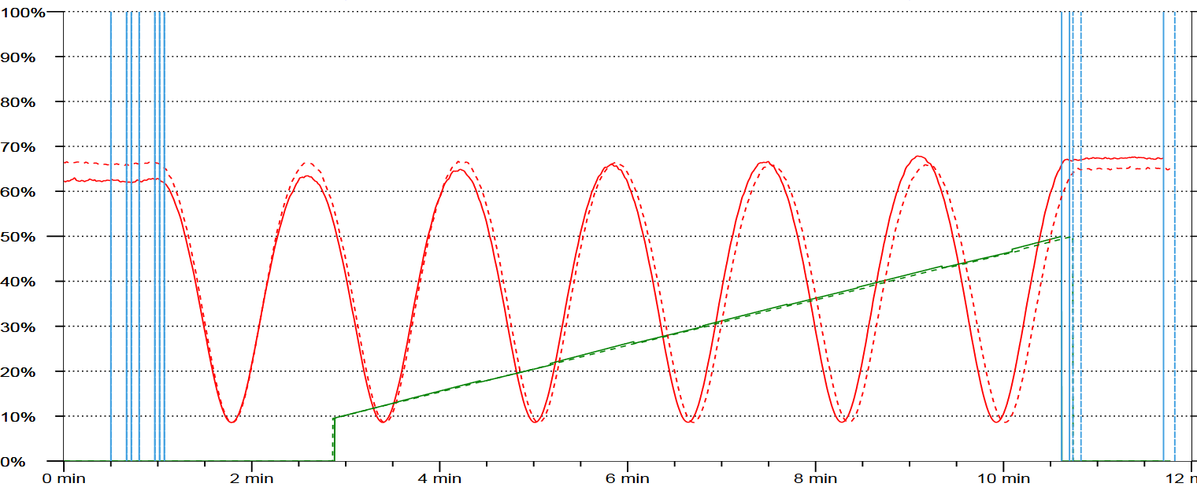
Corial process solution
SiN Deposition Process
Process control by laser interferometry
Deposition stop after 1 µm is deposited
Superposition of signals for different runs

Slide 8
System description corial D250

Slide 9
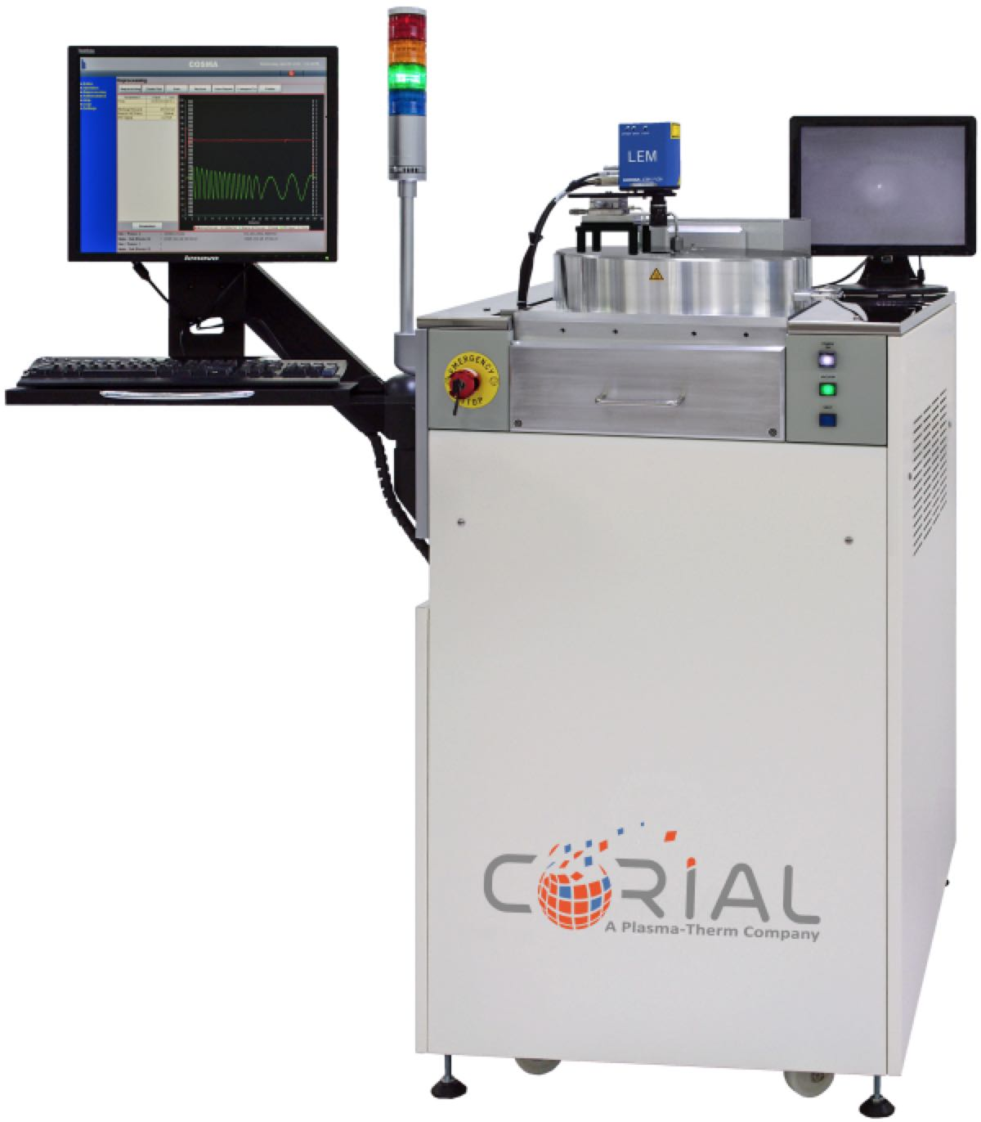
Corial equipment
Corial D250
This machine can be operated in PECVD mode.
For up to 200 mm substrates,
Compact footprint,
Uniformly heated pressurized rector design for high uniformity of thickness and deposited film properties,
Film stress control with a single RF frequency,
Efficient plasma cleaning allowing to eliminate manual cleaning,
Laser end point detector for in-situ film thickness control.

Slide 10
Process solution sin etching with pr mask

Slide 11
Sample structure
SiN Etch Process
4” Quartz wafer patterned with PR mask
and underlayer Cr
80 um
80 um
PR (3 um)
PR (3 um)
PR
PR
SiN (1 um)
SiN (1 um)
Cr pads (1000 Å)
Cr pads(1000 Å)
4’’ quartz wafer (500 um)
4’’ quartz wafer (500 um)

Slide 12
Process requirements
SiN Etch Process
High etching uniformity at ± 3%
High etch rate
Process ready for mass production
Minimum CD loss
No damage to underlayer and wafer
No striations of the sidewalls
Careful control of etch selectivity
Etch-stop on Cr layer
Vertical profile (etch slope > 85°)
Targeted process performances
Process | Etch rate nm/min | Selectivity vs. PR
RIE | 60 | > 2
ICP-RIE | 250 | > 2

Slide 13
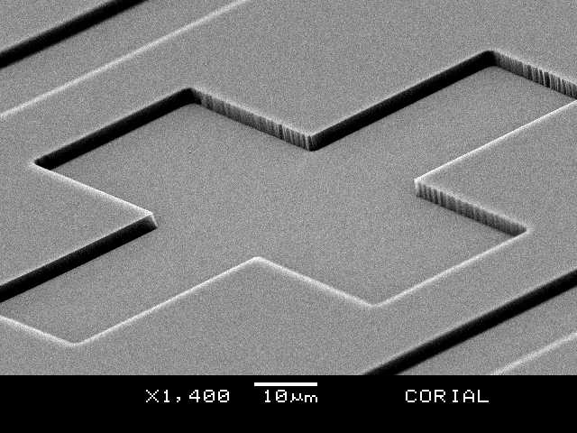
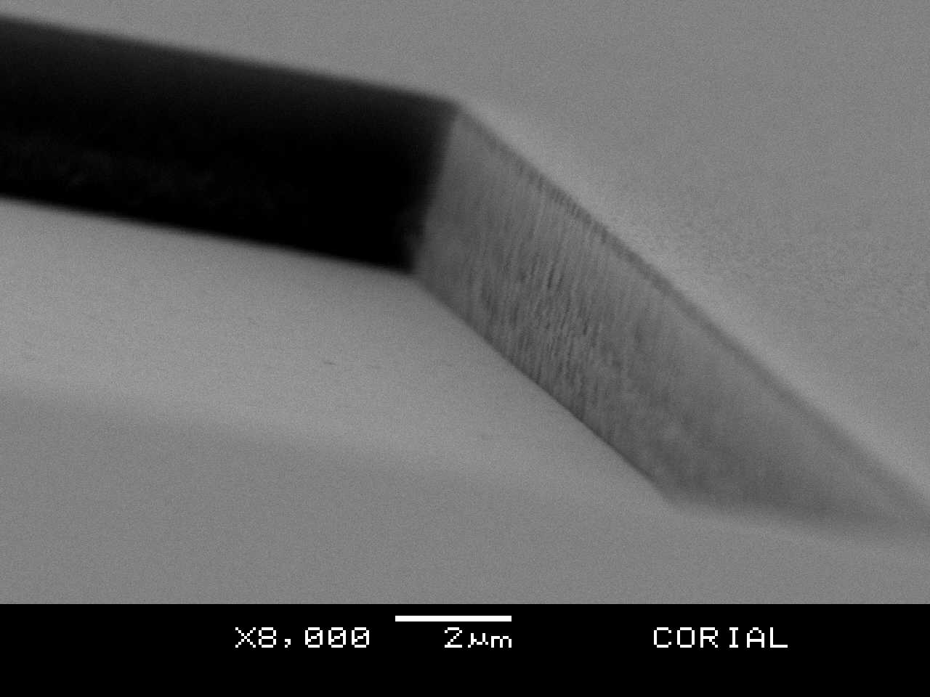
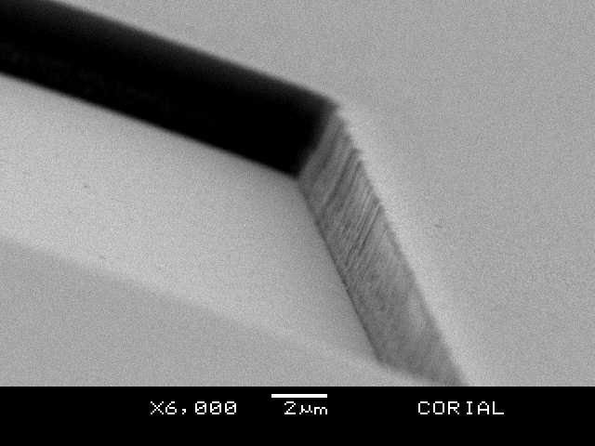
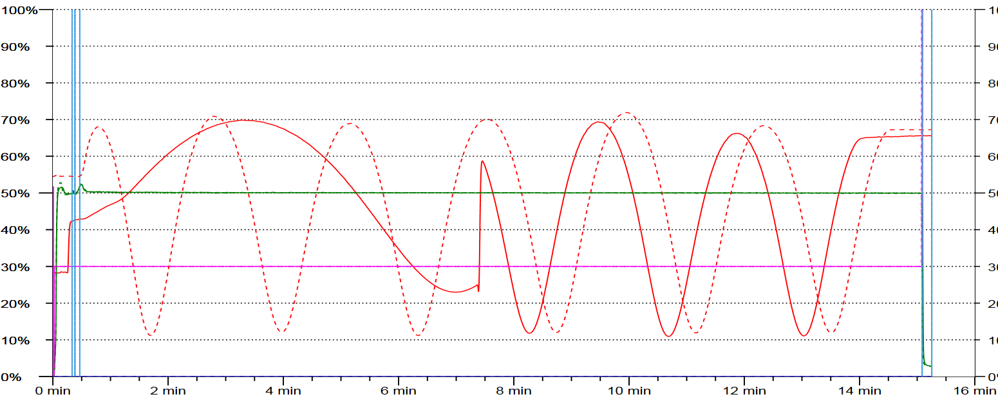
Corial process solution
SiN Etch Process
SiN ETCH RIE MODE
Mask pattern before etching
Process tuning in RIE mode with wafer fragments
RIE etching on full wafers
Multiple runs
1
2
3
PR thickness 3 um with slightly positive profile
Some striation on the walls
No trenching or damage
Vertical profile
Clean corners at the bottom of etched walls
EPD-based adjustment of process duration depending on SiN film thickness

Slide 14
Corial process solution
SiN Etch Process
CORIAL RIE process performances on 4’’ wafer
Process | Chemistry | Mask | Selectivity to mask | Etch profile | Etch rate (nm/min) | Uniformity
SiN etching | CHF₃ & O₂ | PR | > 2.6 | > 85° | > 70 | < 1.5
Process conditions: 50 mTorr, 20°C, RF 150W, CHF₃ 100 sccm, O₂ 6 sccm
In-situ process control by EPD
No trenching by the SEM
No damage to Cr underlayer or PR
Wall roughness as good as PR mask

Slide 15
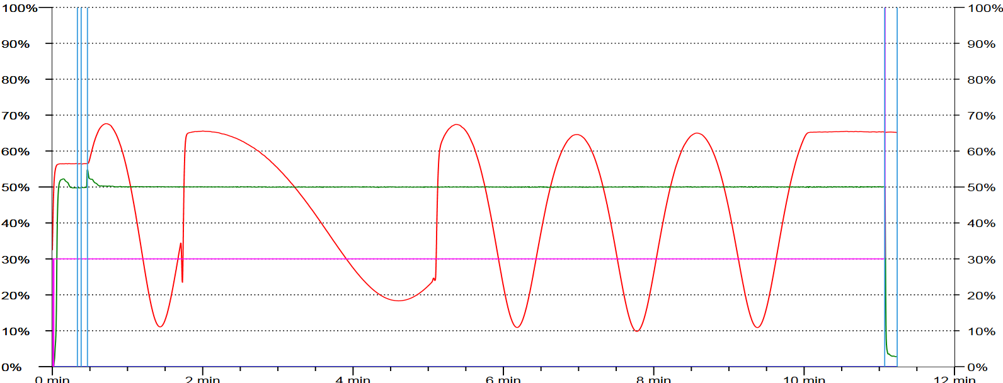
Corial process solution
SiN Etch Process
Process control by laser interferometry (RIE mode)
Cr underlayer is reached
SiN etching
Overetch
Laser on PR
Laser on SiN
Red curve shows the EPD signal

Slide 16
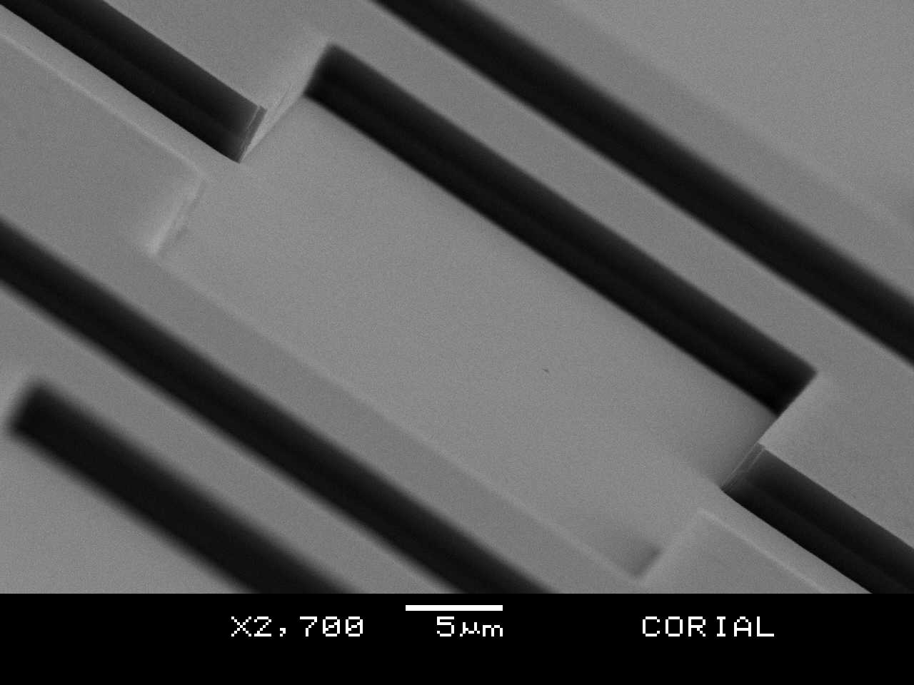
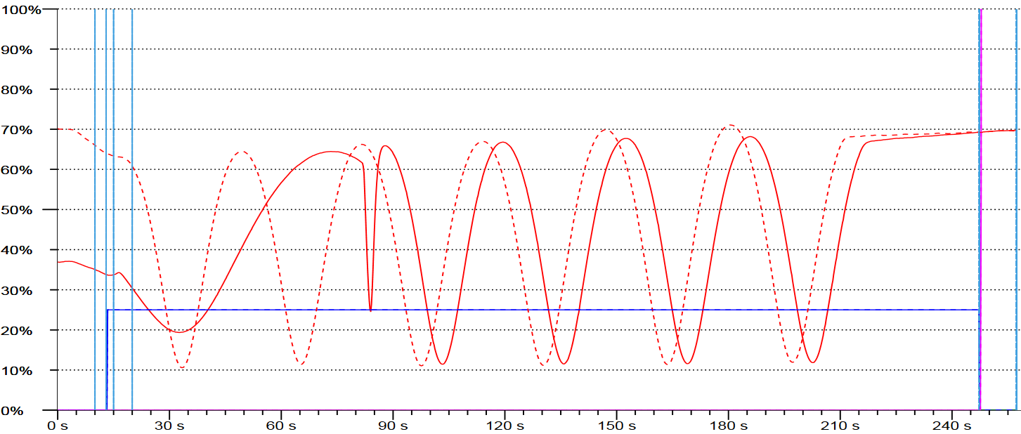
Corial process solution
SiN Etch Process
SiN ETCH ICP-RIE MODE
Mask pattern before etching
Process tuning in ICP-RIE mode with wafer fragments
ICP-RIE etching on full wafers
Multiple runs
1
2
3
PR thickness 3 um with slightly positive profile
Some striation on the walls
EPD-based adjustment of process duration depending on SiN film thickness

Slide 17
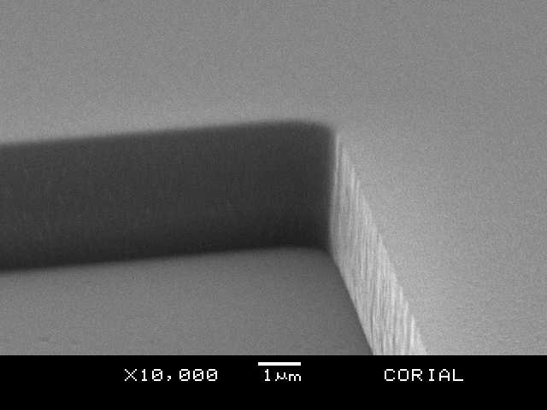
Corial process solution
SiN Etch Process
CORIAL ICP-RIE process performances on 4’’ wafer
Process | Chemistry | Mask | Selectivity to mask | Etch profile | Etch rate (nm/min) | Uniformity
SiN etching | CHF₃ | PR | 2 | > 85° | 380 | < 1.5
Process conditions: 2 mTorr, 20°C, RF 150W, ICP 650W, CHF₃ 35 sccm
In-situ process control by EPD
Clean etching without residues and particles
Cr surface reached smoothly

Slide 18
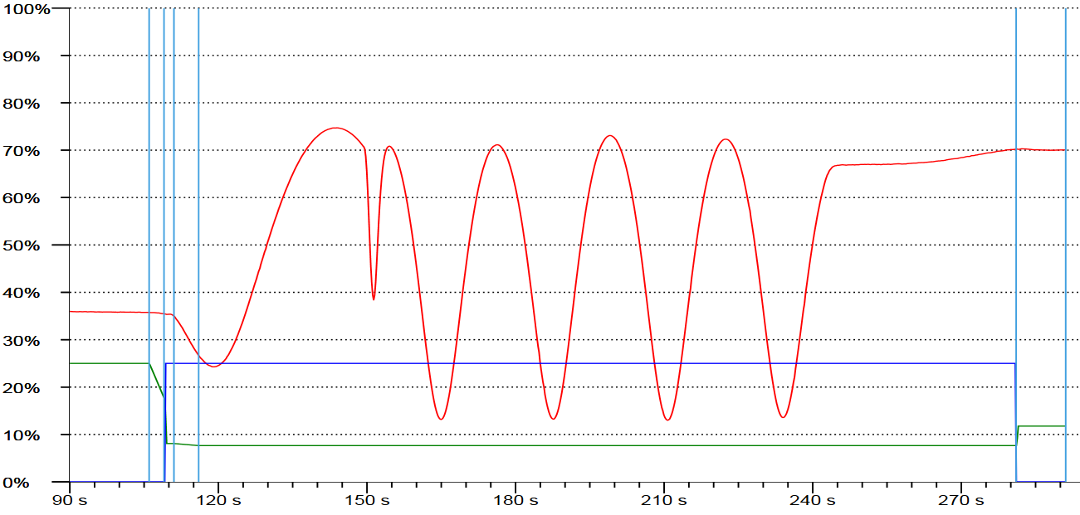
Corial process solution
SiN Etch Process
Process control by laser interferometry (ICP-RIE mode)
Cr underlayer is reached
SiN etching
Overetch
Laser on PR
Laser on SiN
Red curve shows the EPD signal

Slide 19
System description corial 210IL

Slide 20
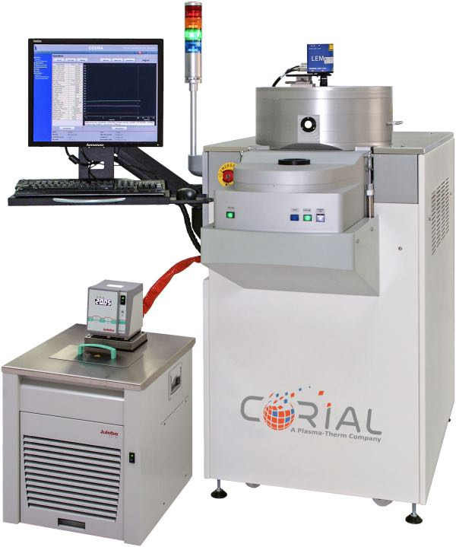
Corial equipment
Corial 210IL
This machine can be operated in both RIE and ICP-RIE modes.
For up to 200 mm substrates,
Compact footprint,
High power (2 KW) ICP source producing uniform high density plasma,
High power (1 KW) RF source to ensure high etch rates,
Shuttles for efficient adaptation of the tool to different wafer sizes, and soft wafer clamping in ICP-RIE mode
Laser end point detector for measurement of the etching rate and determination of stop-etch point.

Slide 21
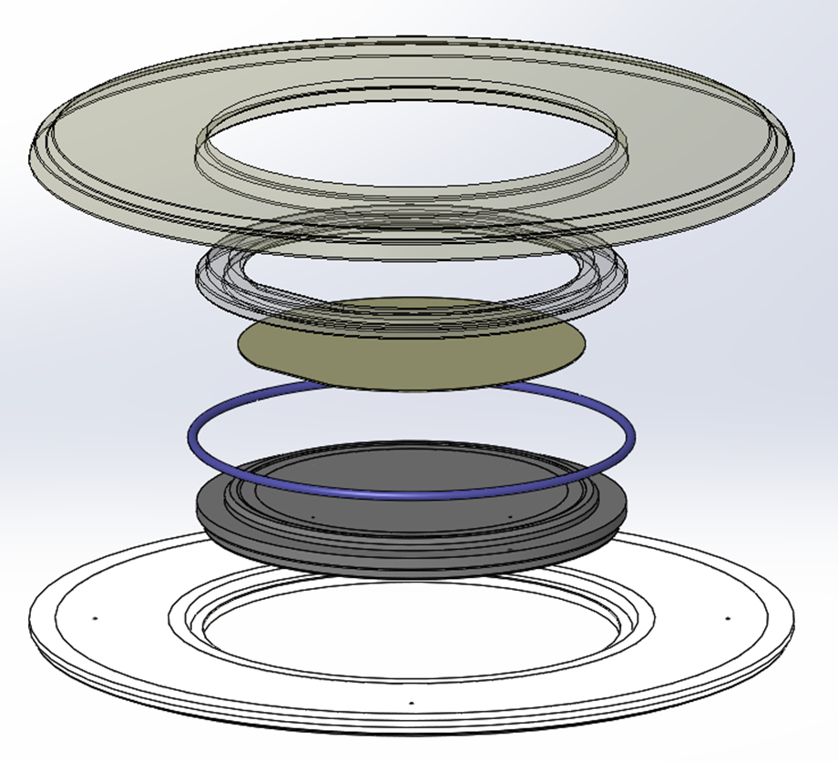
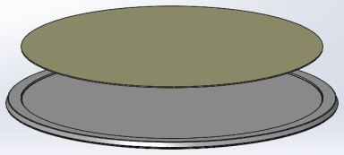
Shuttle holding approach
Corial 210IL
Shuttle NQ200
Shuttle WF100
Guaranteed no wafer damage due to SOFT wafer clamping

Slide 22
Cost of ownership corial 210IL

Slide 23
Throughput and running cost
Corial 210IL
Machine uptime 95%
Installation: footprint 1570 mm x 750 mm + dry pump (can be in grey zone)
Gasses: CHF3, O2, He + Exhaust gas scrubbing
Cooling water, CDA, N2
Consumables: 2,000 Euro per year (quartz clamping ring of WF100 shuttle).
1 x 100 mm wafers per process
Reactor venting – wafer loading & unloading – pumping – process preparation & process end = 180 s;
Etching process = 240 s
Max throughput (8 hours/day, 20 days/month, 95% uptime) = 1350 w/month

