Slide 1
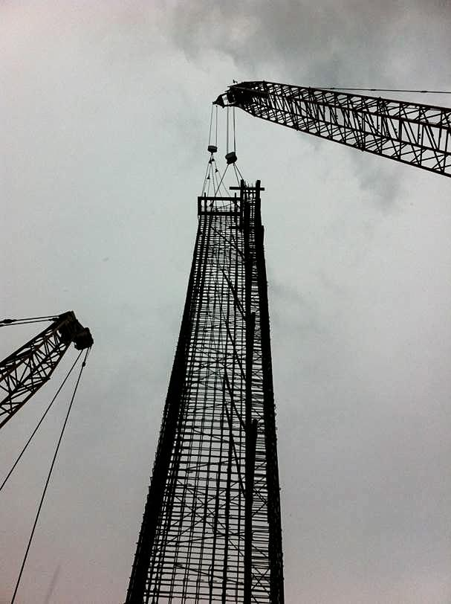
Safe Lifting and Handling of Rebar Cages – Deep Foundations
Presentation By:
Vincent A Siefert, PE
Benjamin Harmon, EIT
Siefert Associates, LLC
ITI Webinar 1.26.16
In Collaboration With Dr. Ahmad Itani University of Nevada-Reno

Slide 2
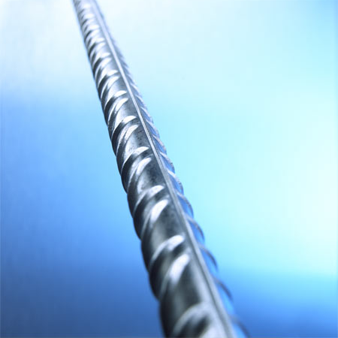
Other Notoriously Difficult Situations
© Siefert Associates, LLC 2016

Slide 3
Notoriously Dangerous Situation
Intended to be a Family Fun Lawn Game Originated in 1961 and by the 80’s it’s so Popular there were
14 Different Manufacturers
6,100 People sent to ER in 8 yr Period
Jarts were Permanently banned in the US the week before Christmas 1988
Notorious- Unexpectedly Dangerous!
© Siefert Associates, LLC 2016

Slide 4
Serious Danger on our Jobsites
Unexpectedly Sudden Collapse of a Rebar Cage
© Siefert Associates, LLC 2016

Slide 5
More Danger on the Job
© Siefert Associates, LLC 2016

Slide 6
DANGER HERE
© Siefert Associates, LLC 2016

Slide 7
DANGER THERE!
Fabrication and Erection Based on Experience and Rule of Thumb-Little or No Engineering Guidance is Available-Pier Columns are shown,
Foundation Element Failures - Seldom Photographed or Discussed Externally-Big Problem
© Siefert Associates, LLC 2016

Slide 8
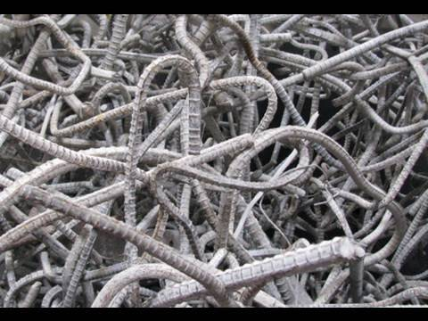
BIG PROBLEM–REBAR CAGE COLLAPSE
Material Damage
Equipment Damage
Delays to Schedule
Added Costs
In CA there were 56 documented collapses between 1995 to 2010.
Contractors Seldom Share their Lessons Learned
© Siefert Associates, LLC 2016

Slide 9
BIGGER PROBLEMS
Damage to Property
Injury
Death
Nationally there have been at least 3 fatalities per year and dozens of serious injuries between 2005-2013
Action is Needed!
Construction worker Eduardo Leite, 24
Accident occurred on Aug 18, 2012
Yes, this worker Survived!
© Siefert Associates, LLC 2016

Slide 10
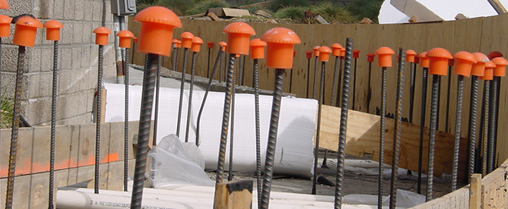
PROBLEM-NOT EASILY SOLVED
Rebar Impalement #1 cause of Death on Construction Sites (61%)
Hardhats not able to Protect Workers from Falling Rebar
Funding for Additional Research has not been a priority for Public Agencies - mainly since this Hazard primarily affects Contractor's Employees only and not the General Public!
© Siefert Associates, LLC 2016

Slide 11
Outline
Preface-Danger that Surrounds our Jobsites
Previous Slides
Anatomy of a Rebar Cage
General Crane and Rigging Practices
Single Crane, Two Cranes, Tilt Table
Handling, Upending and Final Vertical Lift
Construction Engineering Challenges
Brief Intermission
Most Recent Research Findings
Current Trends in the Field
Best Practices for the Four Main Players
Permanent Design Engineer
Contractors
Construction Engineer
Fabricator / Erector
Recommendations
© Siefert Associates, LLC 2016

Slide 12
Anatomy of a Rebar Cage
© Siefert Associates, LLC 2016

Slide 13
Deep Foundation Rebar Cages – Drilled Shafts and Slurry Wall Panels
EE Cruz Const. Inc. Columbia University Manhattanville Campus NYC
© Siefert Associates, LLC 2016

Slide 14
Field Fabricated
It's unfair to rely solely on the Ironworker’s to take full responsibility for the
Safe Lifting and Handling of Cages
© Siefert Associates, LLC 2016

Slide 15
Shop Fabricated
Advantage -Controlled Environment- Courtesy of Dimension Fabricators Scotia,NY
© Siefert Associates, LLC 2016

Slide 16
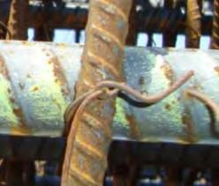
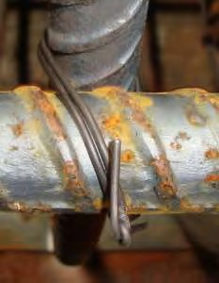
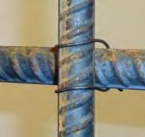
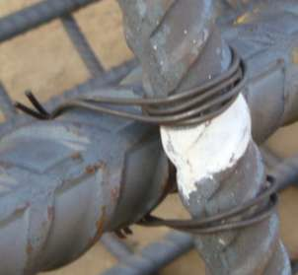
Tie Wire Connection Types per CRSI
Single Snap
Double Snap
Single U-Tie
Double U-Tie
Column Tie
Double Wrap & Saddle
© Siefert Associates, LLC 2016

Slide 17
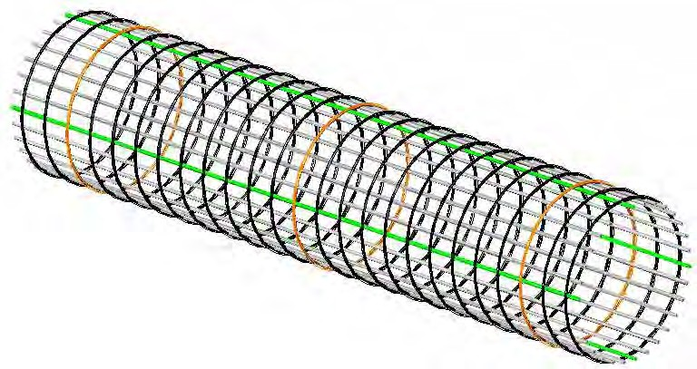
Anatomy Lesson 101
Main Cage Components
• Template Hoops (Orange Color)
• Pick Up Bars (Green Color)
Ref: A. Itani Publication
© Siefert Associates, LLC 2016

Slide 18
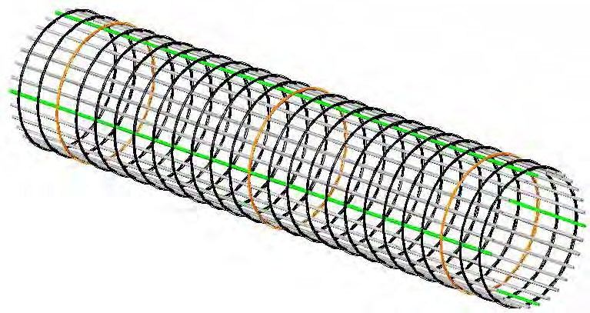
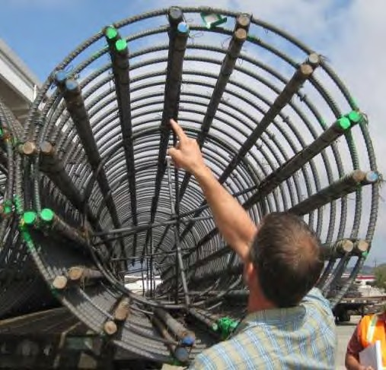
Pick Up Bars
• Four longitudinal bars that form a square
• Tie at every intersection
• Double snap tie, Quadruple snap tie
• Crosby Clip Spliced Pickup Bars- Alternate
© Siefert Associates, LLC 2016

Slide 19
Template Hoops or Crush Rings
Spaced at 8 to 10 ft
Tied at every intersection with the longitudinal Rebar
Double U-Tie, Wrap-and-Saddle
Alt-Fabricated Steel Rings
© Siefert Associates, LLC 2016

Slide 20
Internal Bracing
Shown in Red
Min 4-#8 Rebar
Spaced 10ft o/c
Connected to Hoops
Tied to Pickup Bars
Alt- Structural Steel or Prefab
© Siefert Associates, LLC 2016

Slide 21
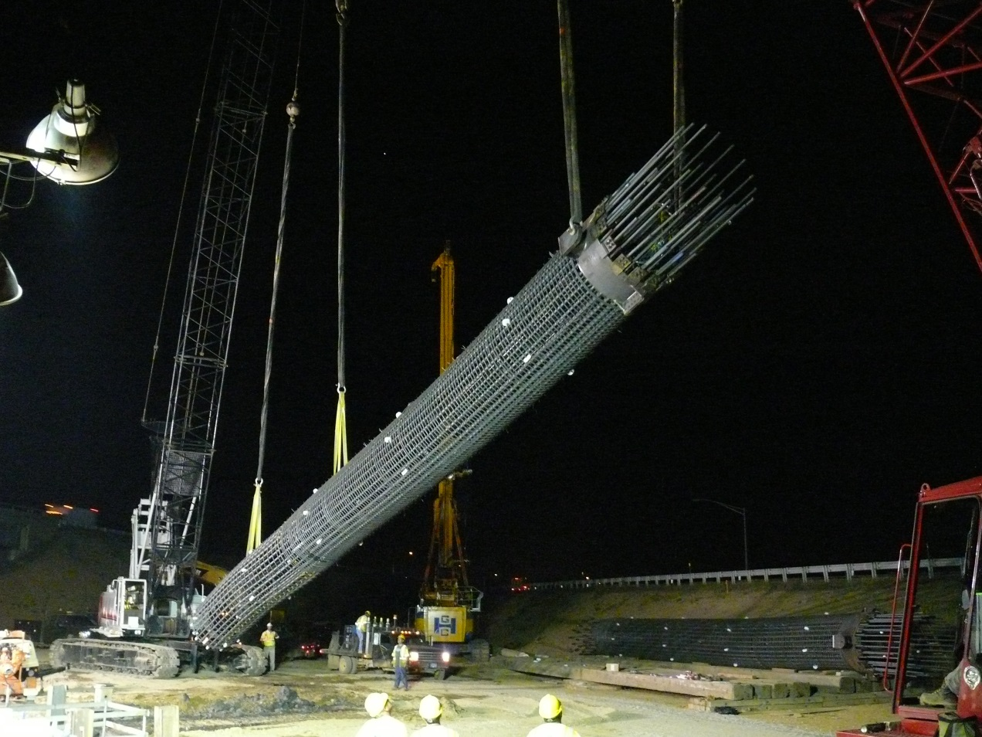
General Crane and Rigging Practices
Most Critical Operation is the Upending Process
© Siefert Associates, LLC 2016

Slide 22
Crane Layout Plans
Single Crane Lift
Courtesy of Dimension Fabricators Inc
© Siefert Associates, LLC 2016

Slide 23
Single Crane Lift
Single Crane 1 rig point 20ft max, 2 rigging pt 40ft-60ft
© Siefert Associates, LLC 2016

Slide 24
Two Crane Lift
Two Cranes shown, One Crane with 2 hooks sim, 2pt rigging 50ft shown, up to 130ft possible
© Siefert Associates, LLC 2016

Slide 25
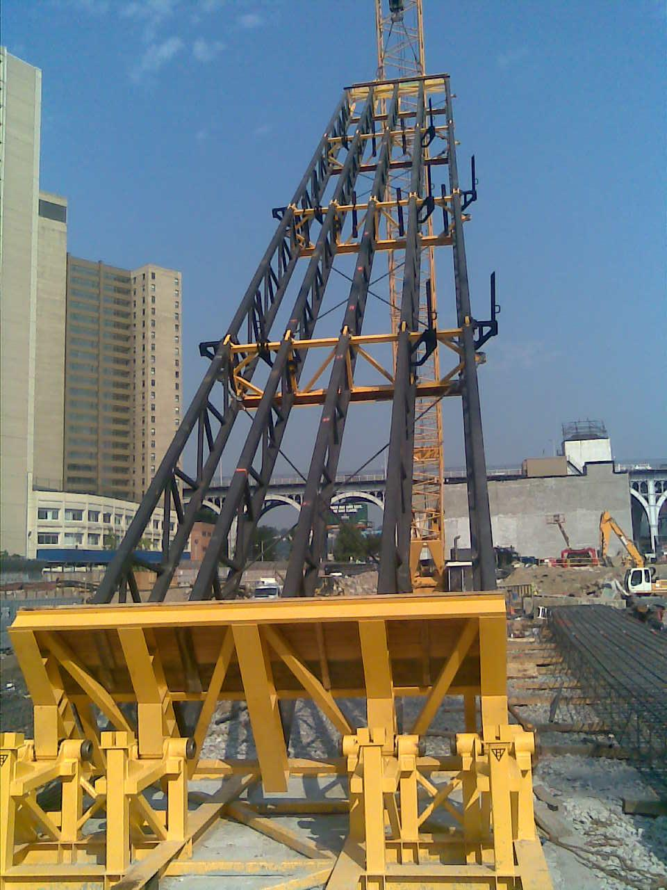
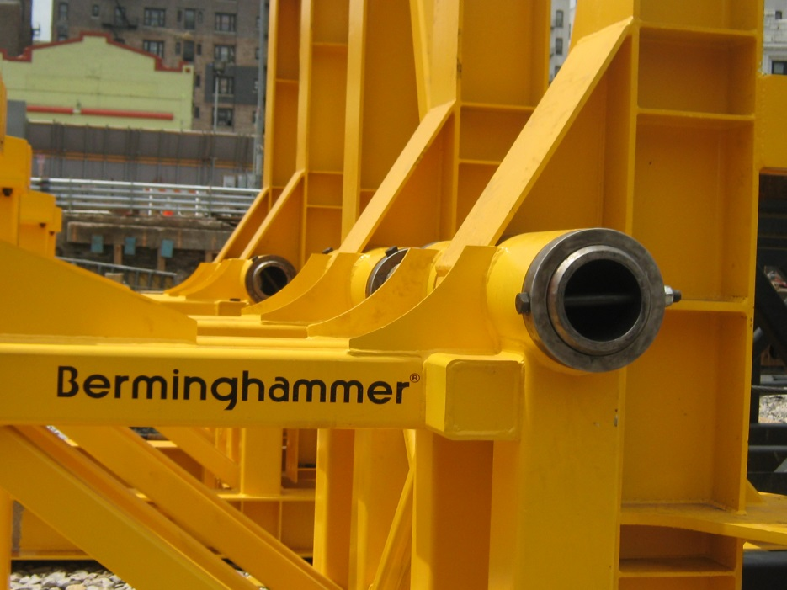
Tilt Table
Bermingham Foundation Solutions
© Siefert Associates, LLC 2016

Slide 26
Tilt Table – Two Crane Lift
Used for very long cages up to 120ft-and Beyond
© Siefert Associates, LLC 2016

Slide 27
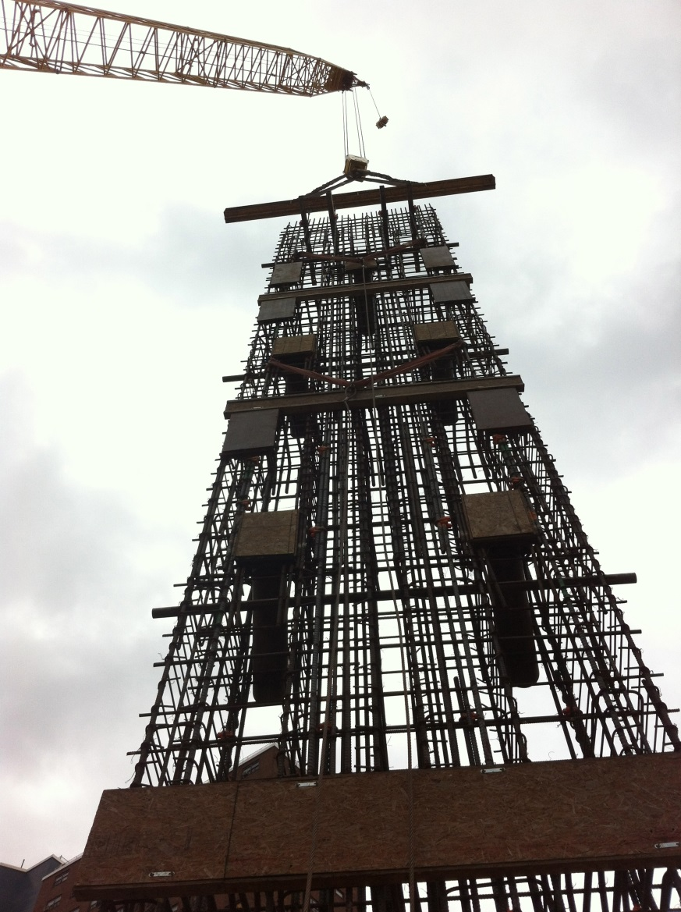
Vertical Cage – Safely Upended
© Siefert Associates, LLC 2016

Slide 28
Rigging Practices
Special Rigging for Delivery, Handling and Staging
© Siefert Associates, LLC 2016

Slide 29
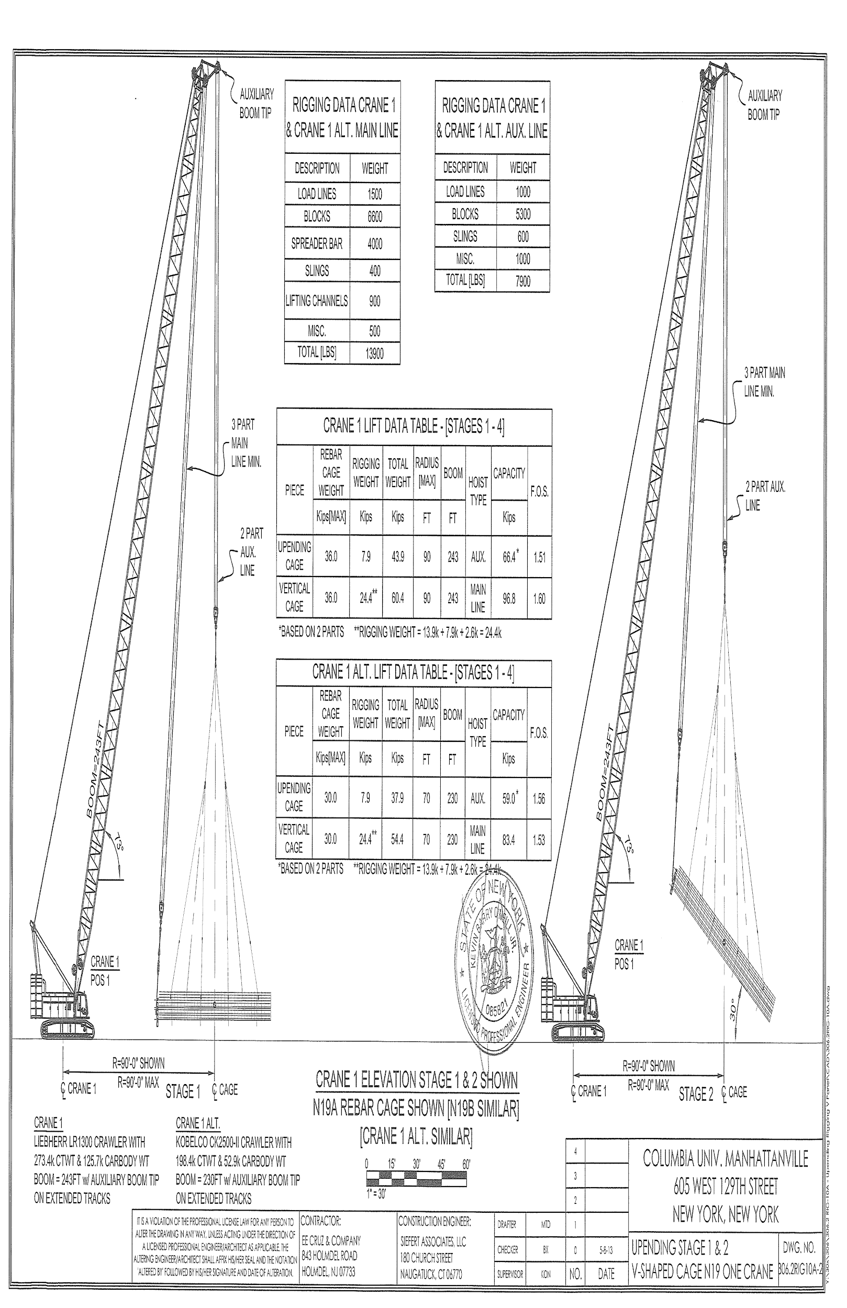
Upending Rigging - Single Crane with Two Hooks
© Siefert Associates, LLC 2016

Slide 30
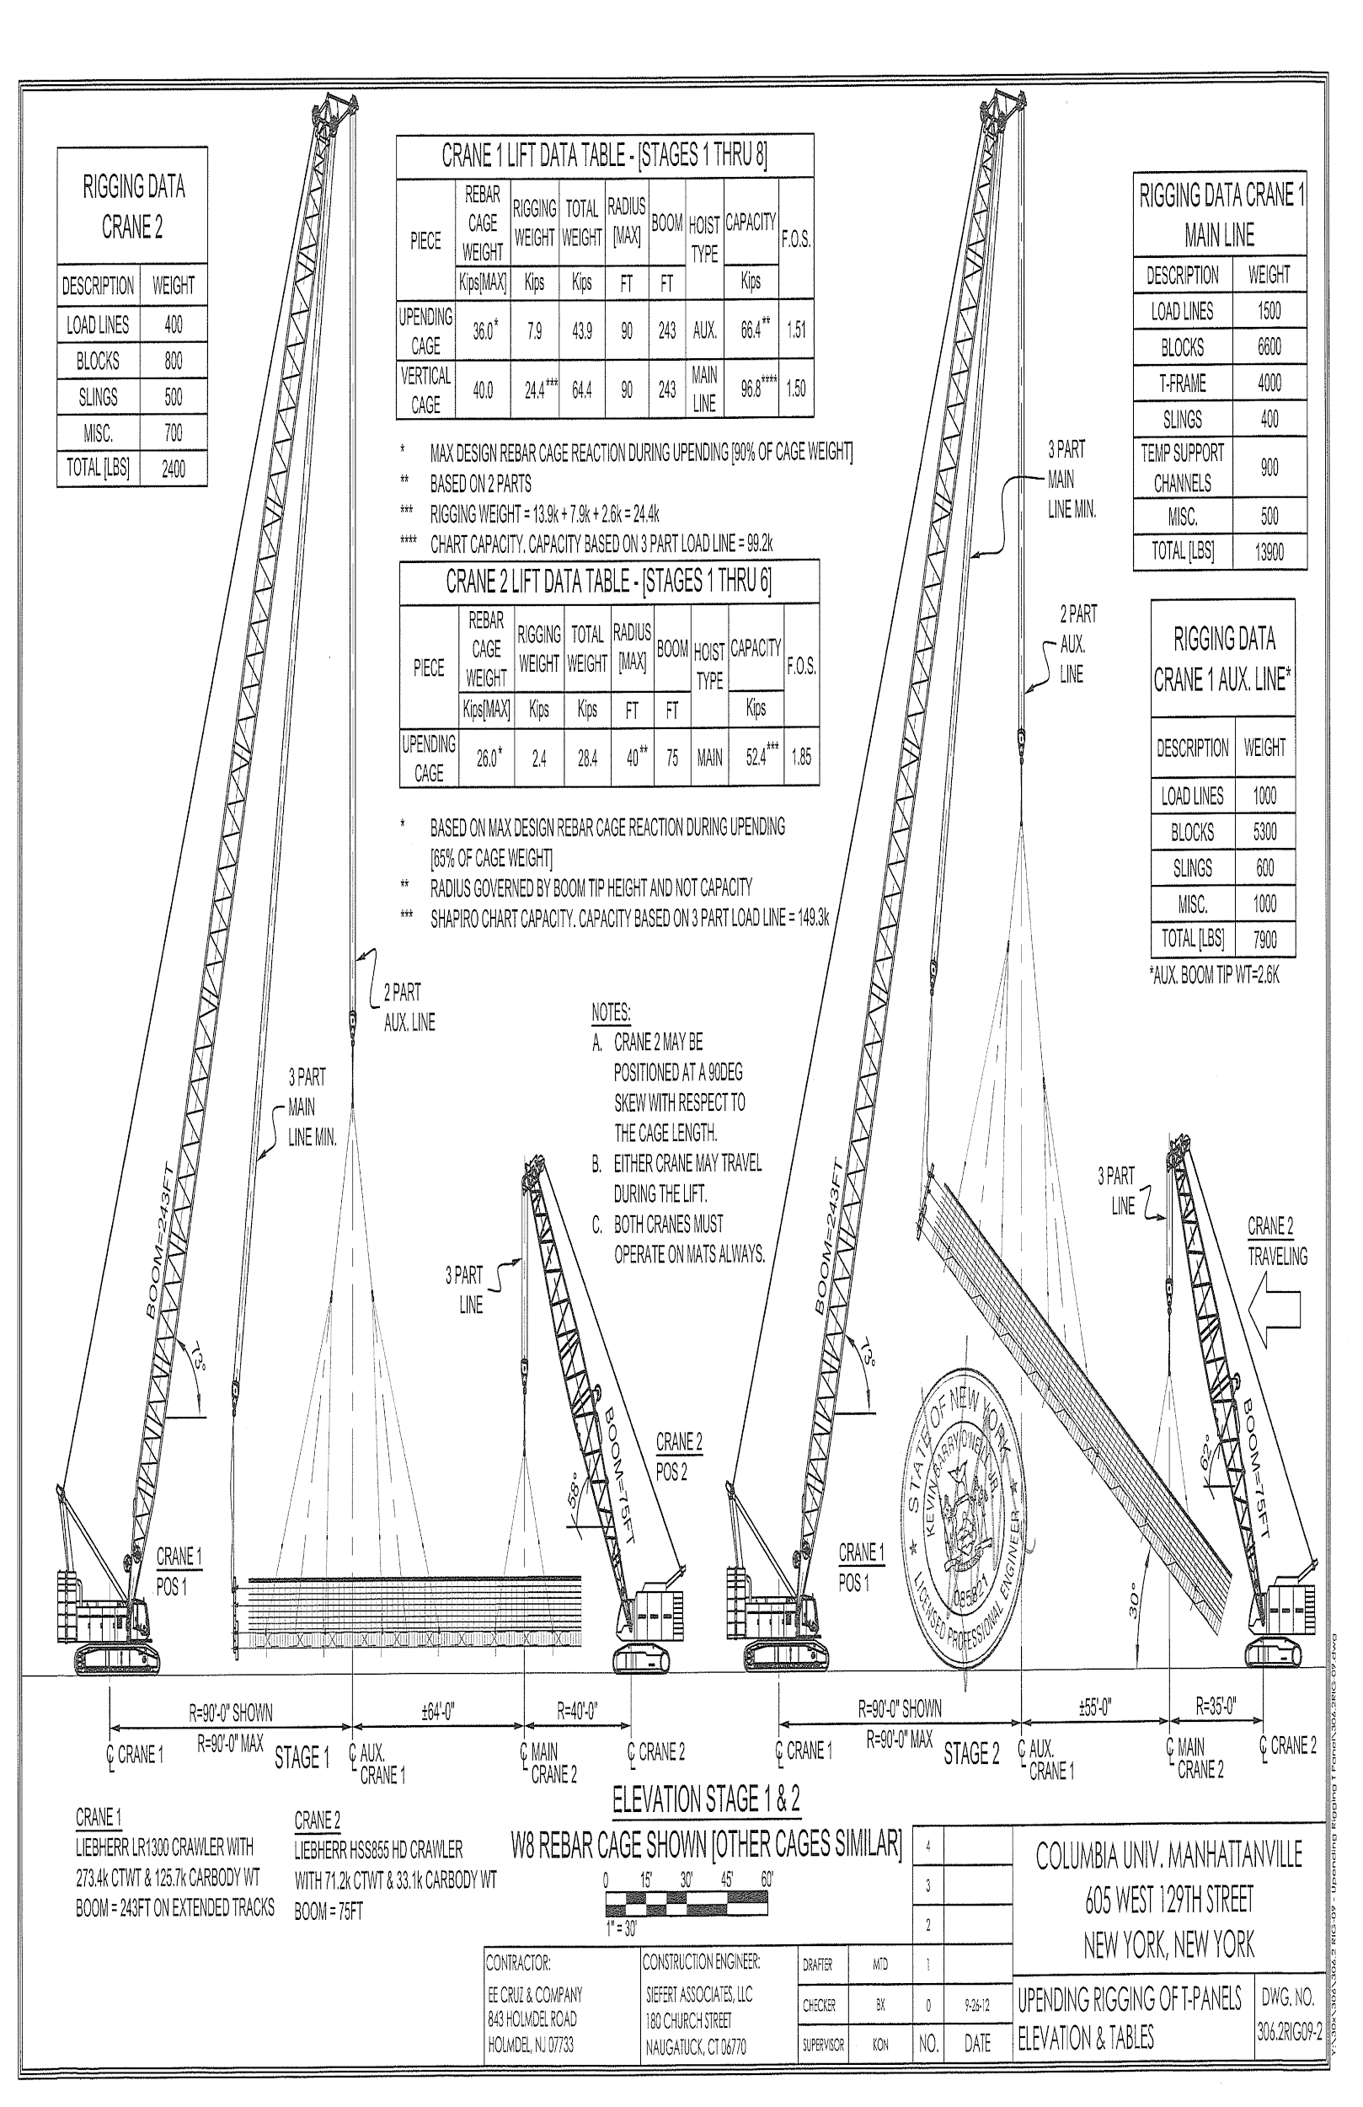
Upending Rigging with Two Cranes
© Siefert Associates, LLC 2016

Slide 31
Crane 1
Crane 2
Rigging for Upending Operation
© Siefert Associates, LLC 2016

Slide 32
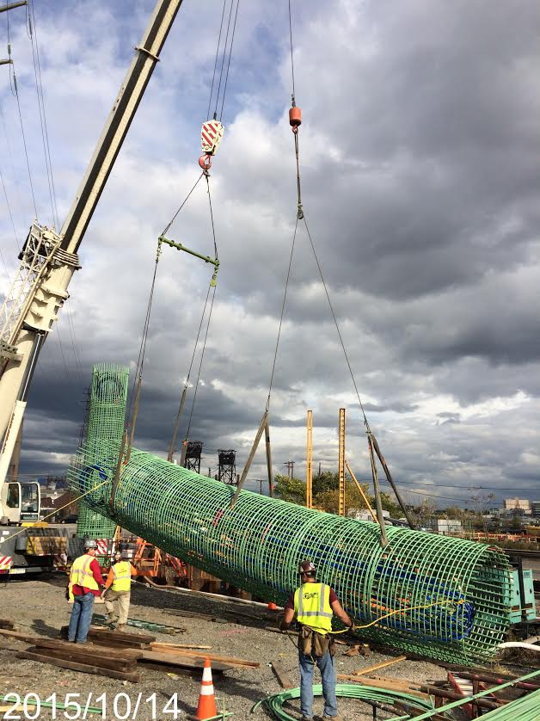
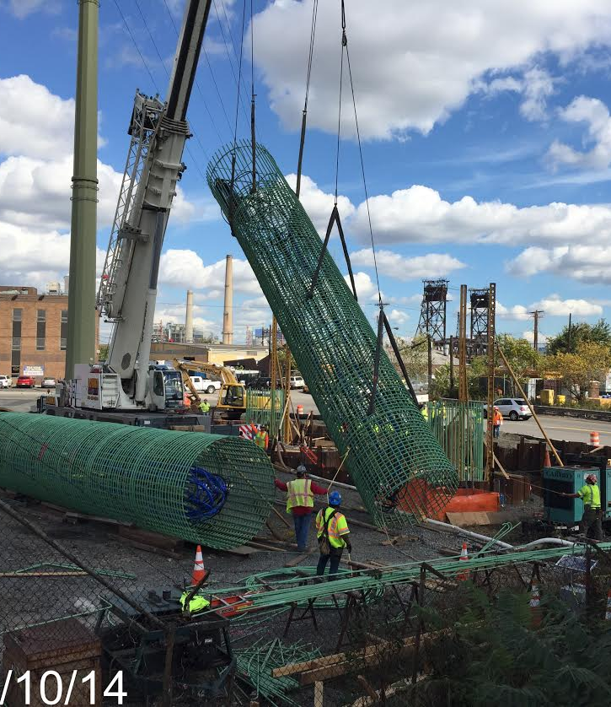
Rigging for Upending
Courtesy CCA Civil Inc, Wittpenn Br, Jersey City NJ
© Siefert Associates, LLC 2016

Slide 33
Construction Engineering Challenges
Determining the Structural Stability of a “Wet Noodle”

Slide 34
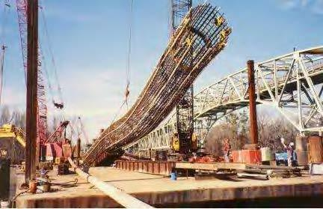
Slurry Wall Cage at World Trade Center (left)
Drilled Shaft at unknown bridge site (below)
Rebar Cages Section Properties are Impossible to Accurately Define
Current General Practice
– Trial and Error!
© Siefert Associates, LLC 2016

Slide 35
Calculating Structural Properties
Moment of Inertia for Rebar Cage
I=∑I₀+β∑Ad²
Parallel Axis Theory:
Sum of Individual Bars + Product of Bar Areas times Square of the Distances
β is a Reduction Factor
Based on connection strength usually tie wire joints
Recommendation – Verify Calculated Section Properties with Full Scale Deflection Test in the Field – As a Separate Operation (Allows for Modifications)
© Siefert Associates, LLC 2016

Slide 36
Tie Wires for Rebar Cages
#15 wire should be used for critical fabrication, #14 even better
Tie Wire Connection types are important too.
Alt.-Use of Weldable Rebar Grade A706 would Provide Much Stronger Joints!
© Siefert Associates, LLC 2016

Slide 37
Const. Engineering Challenges
ITI Webinar July 2015 -Six Most Important Issues during Crane Lifts
© Siefert Associates, LLC 2016
Notes:
Definition of a Lift Plan

Slide 38
#5-Stability of the Lifted Load
Q-What other critical lift is routinely performed on a jobsite without requirement for a stability check??
REBAR CAGES !!
© Siefert Associates, LLC 2016

Slide 39
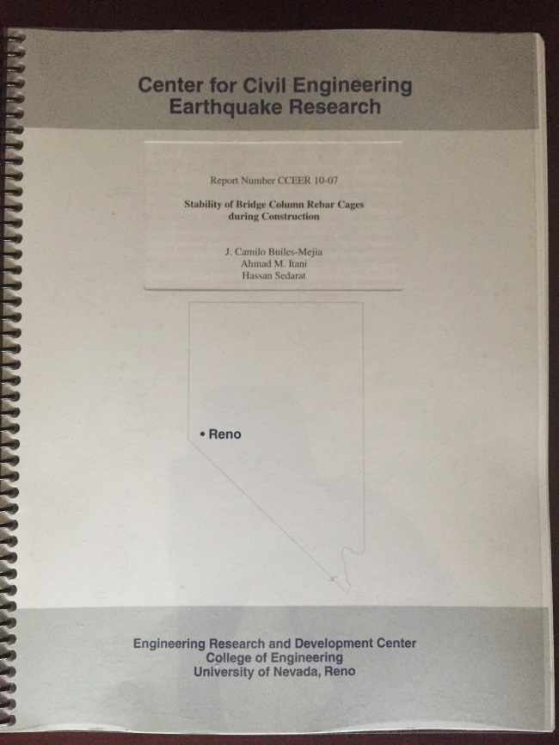
Limited Available Documents
“Stability of Bridge Column Rebar Cages during Construction”
Nov. 2010
Published 2013
Private Contractors, Fabricators and Engineers Internal Documents-Lessons Learned
© Siefert Associates, LLC 2016

Slide 40
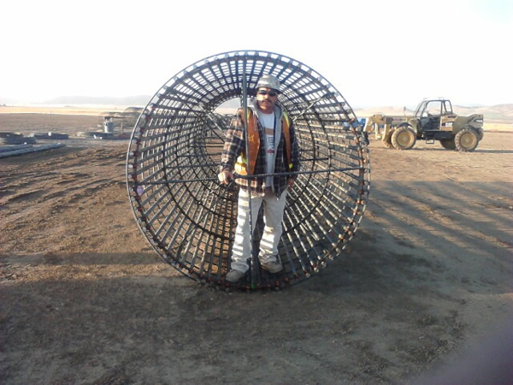
Brief Intermission Slide
Ever Feel Caged In ?
Don’ t be This Guy
Be This Guy!
Part 2 Coming Up
© Siefert Associates, LLC 2016

Slide 41
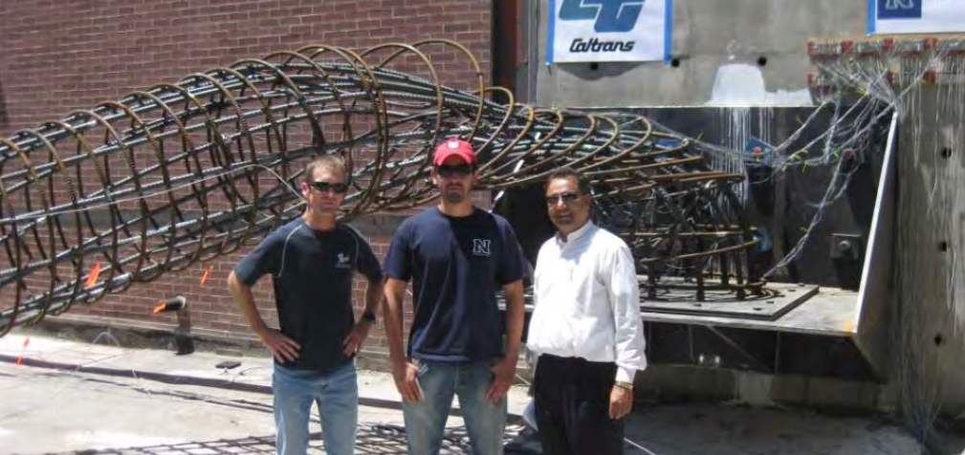
Most Recent Research
“Stability of Bridge Column Rebar Cages during Construction” – Nov. 2010
Ahmad M. Itani, Ph.D., S.E.
Professor at University of Nevada, Reno
J. Camilo Builes-Mejia
Hassan Sedarat
© Siefert Associates, LLC 2016

Slide 42
Ultimate Strength of Tie Wire Connections
Connection Ultimate Strength
Connection Type | Experienced Iron Worker |  |  | Inexperienced Iron Worker
 | N (lb) | T (lb) | R (lb-in) | N (lb) | T (lb) | R (lb-in)
Single Snap | 305 | 269 | 223 | 281 | 186 | 198
Double Snap | 465 | 506 | 469 | 403 | 313 | 510
Single-U | 681 | 469 | 479 | 541 | 544 | 448
Double-U | 1310 | 1034 | 912 | 1025 | 721 | 845
Column Tie | 1101 | 810 | 518 | 972 | 608 | 513
Wrap-and Saddle | 1393 | 1139 | 865 | 1235 | 999 | 692
Strength of connection determines how much bar area can be developed
© Siefert Associates, LLC 2016

Slide 43
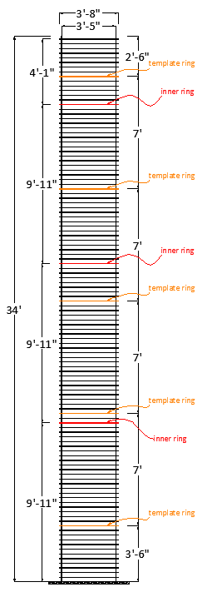
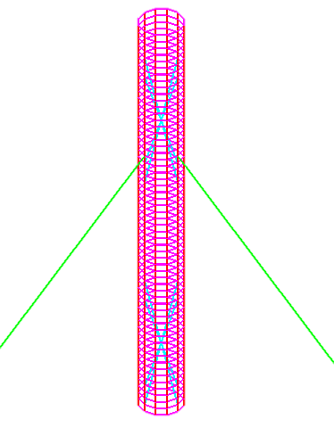
Nonlinear Finite Element Analysis
Four cases analyzed:
Minimum # of ties
Maximum # of ties
Minimum # of ties with X-braces
Minimum # of ties with box braces
© Siefert Associates, LLC 2016

Slide 44
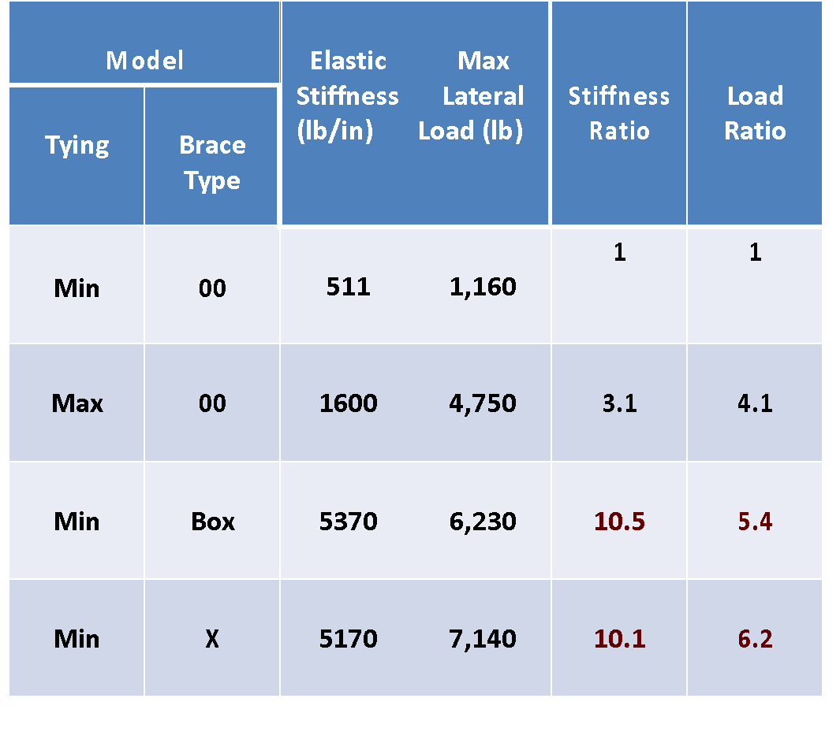
Nonlinear FEA Results
Adding internal bracing is most effective way to increase stiffness
It is not necessary to tie every rebar intersection
© Siefert Associates, LLC 2016

Slide 45
Rebar Cage Experiments
Two full scale specimens
Identical height and diameter (H=34’, D=3’-8”)
Different longitudinal and transverse bar spacing
Different type of internal brace
Specimen | Longitudinal Bars |  | Transverse Bars Brace Type |  | Weight
I | 12#11 | ρ=1% | #8@7” | X ρs=1% 4#8 | 4,100 lb
2 | 24#11 | ρ=2% | #8@3.5” | Square ρs=1% 8#8 | 8,200 lb
© Siefert Associates, LLC 2016

Slide 46
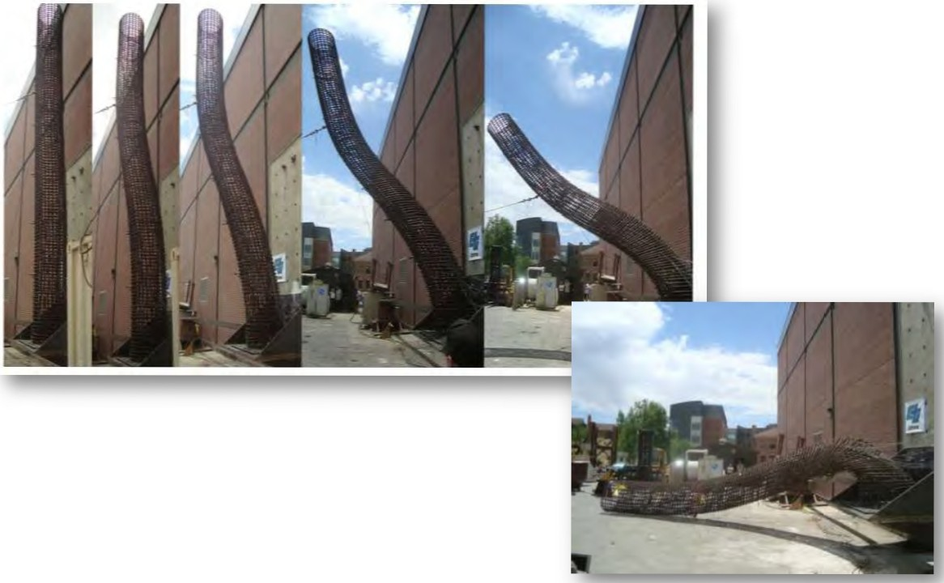
Load Cage to Failure
© Siefert Associates, LLC 2016

Slide 47
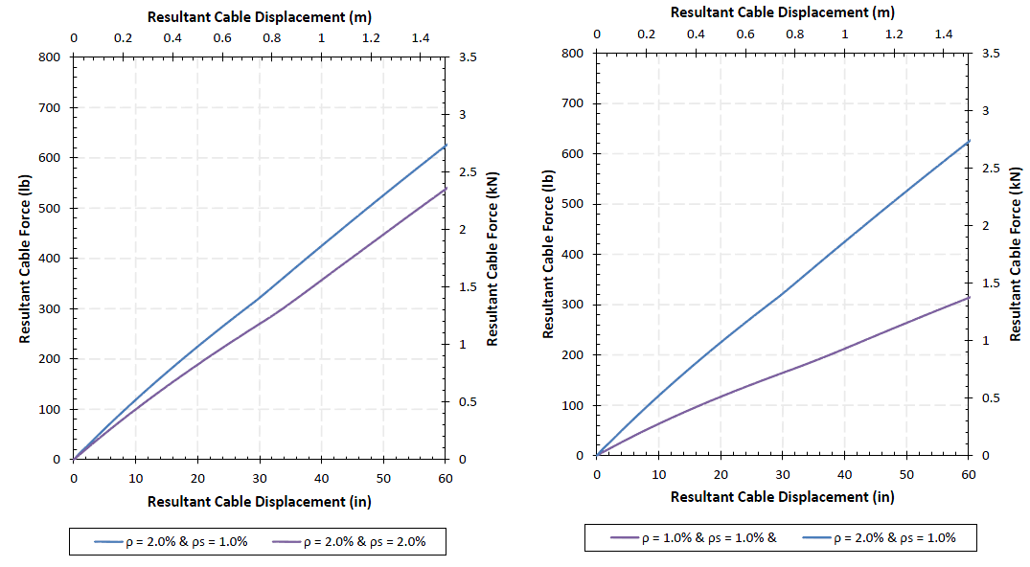
Effect of Reinforcement Area
© Siefert Associates, LLC 2016

Slide 48
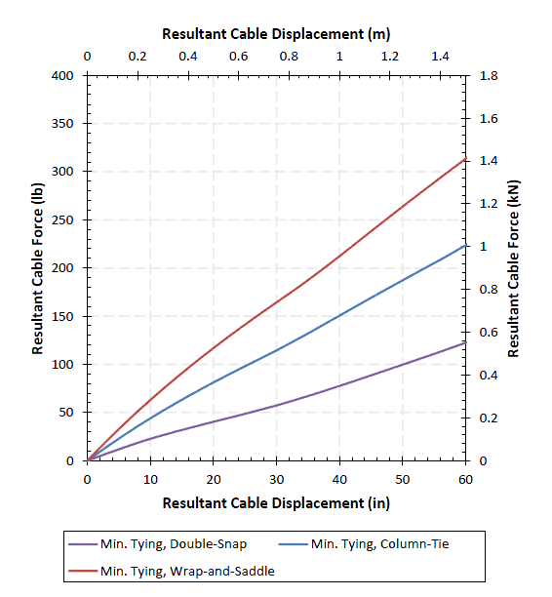
Effect of Tie Wire Connection
© Siefert Associates, LLC 2016

Slide 49
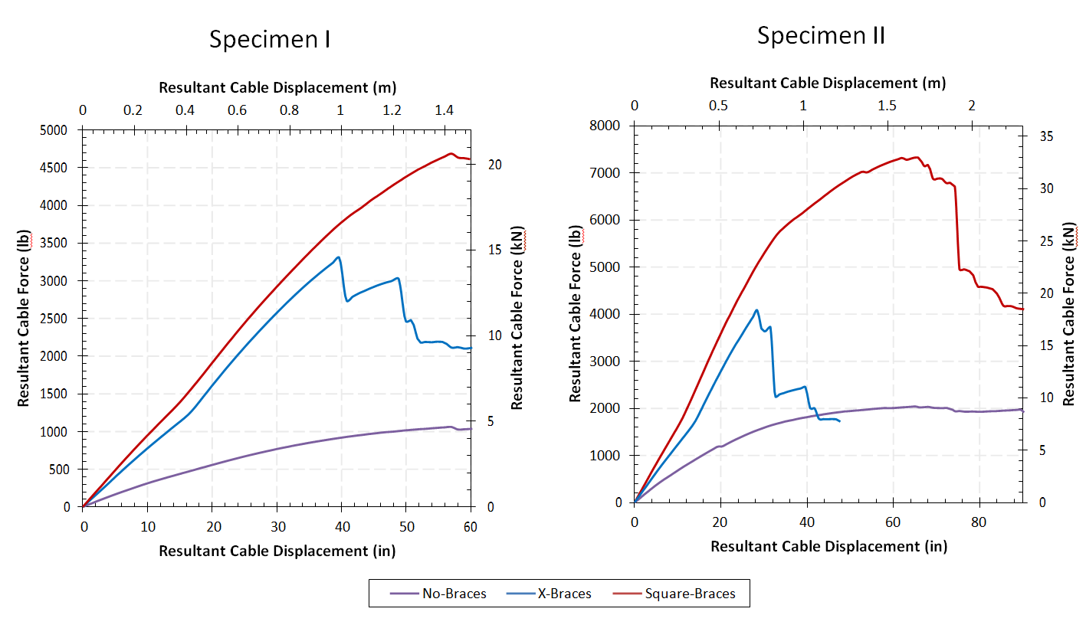
Effect of Internal Bracing
© Siefert Associates, LLC 2016

Slide 50
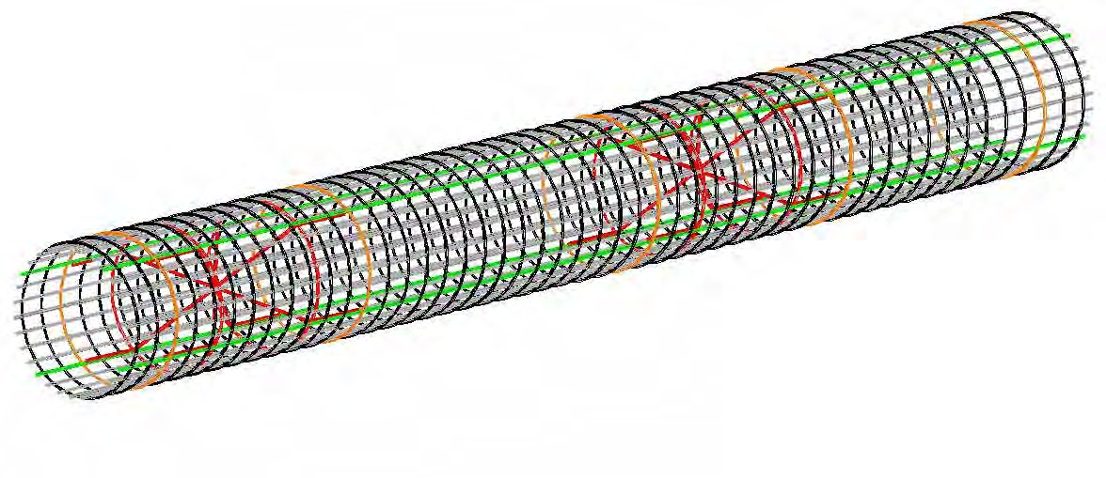
#1 Best Practice Internal Bracing
If H/D > 8 then bracing is required
Two Types: X-Type or Square
#8 bars tied or welded in the middles and spaced at 10 ft
Tied to longitudinal bars and to end rings
© Siefert Associates, LLC 2016

Slide 51
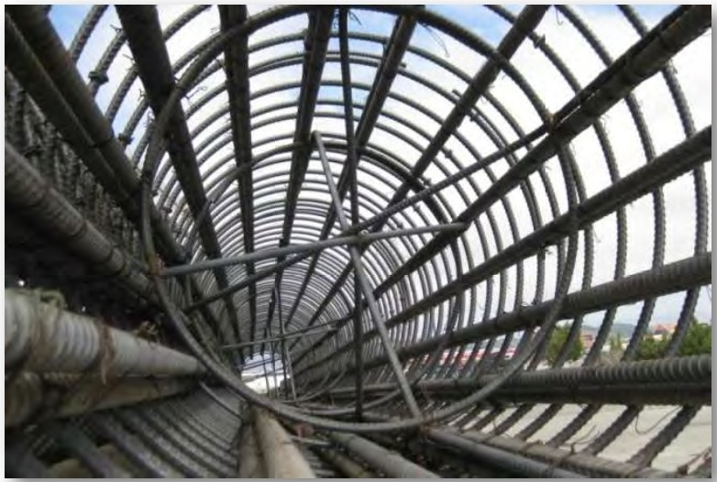
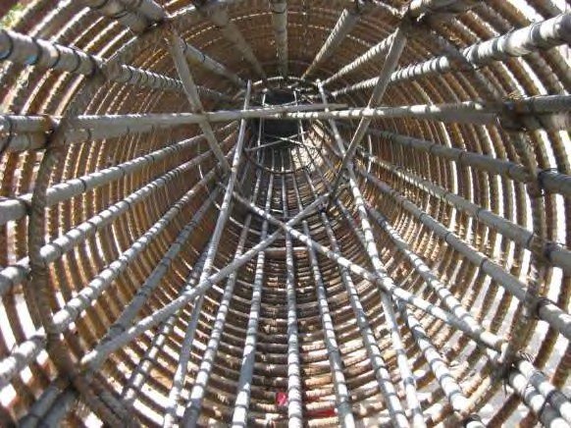
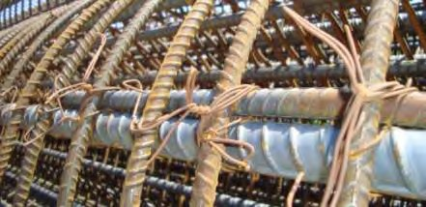
#1 Best Practice Internal Bracing
X-Type Brace Shown Above
Difficult for Concrete Placement
Box or Square Type Shown top Right
-Center is Open for Concrete Tremie Hose
Z-Bars Tied to Pick-Up Bars
© Siefert Associates, LLC 2016

Slide 52
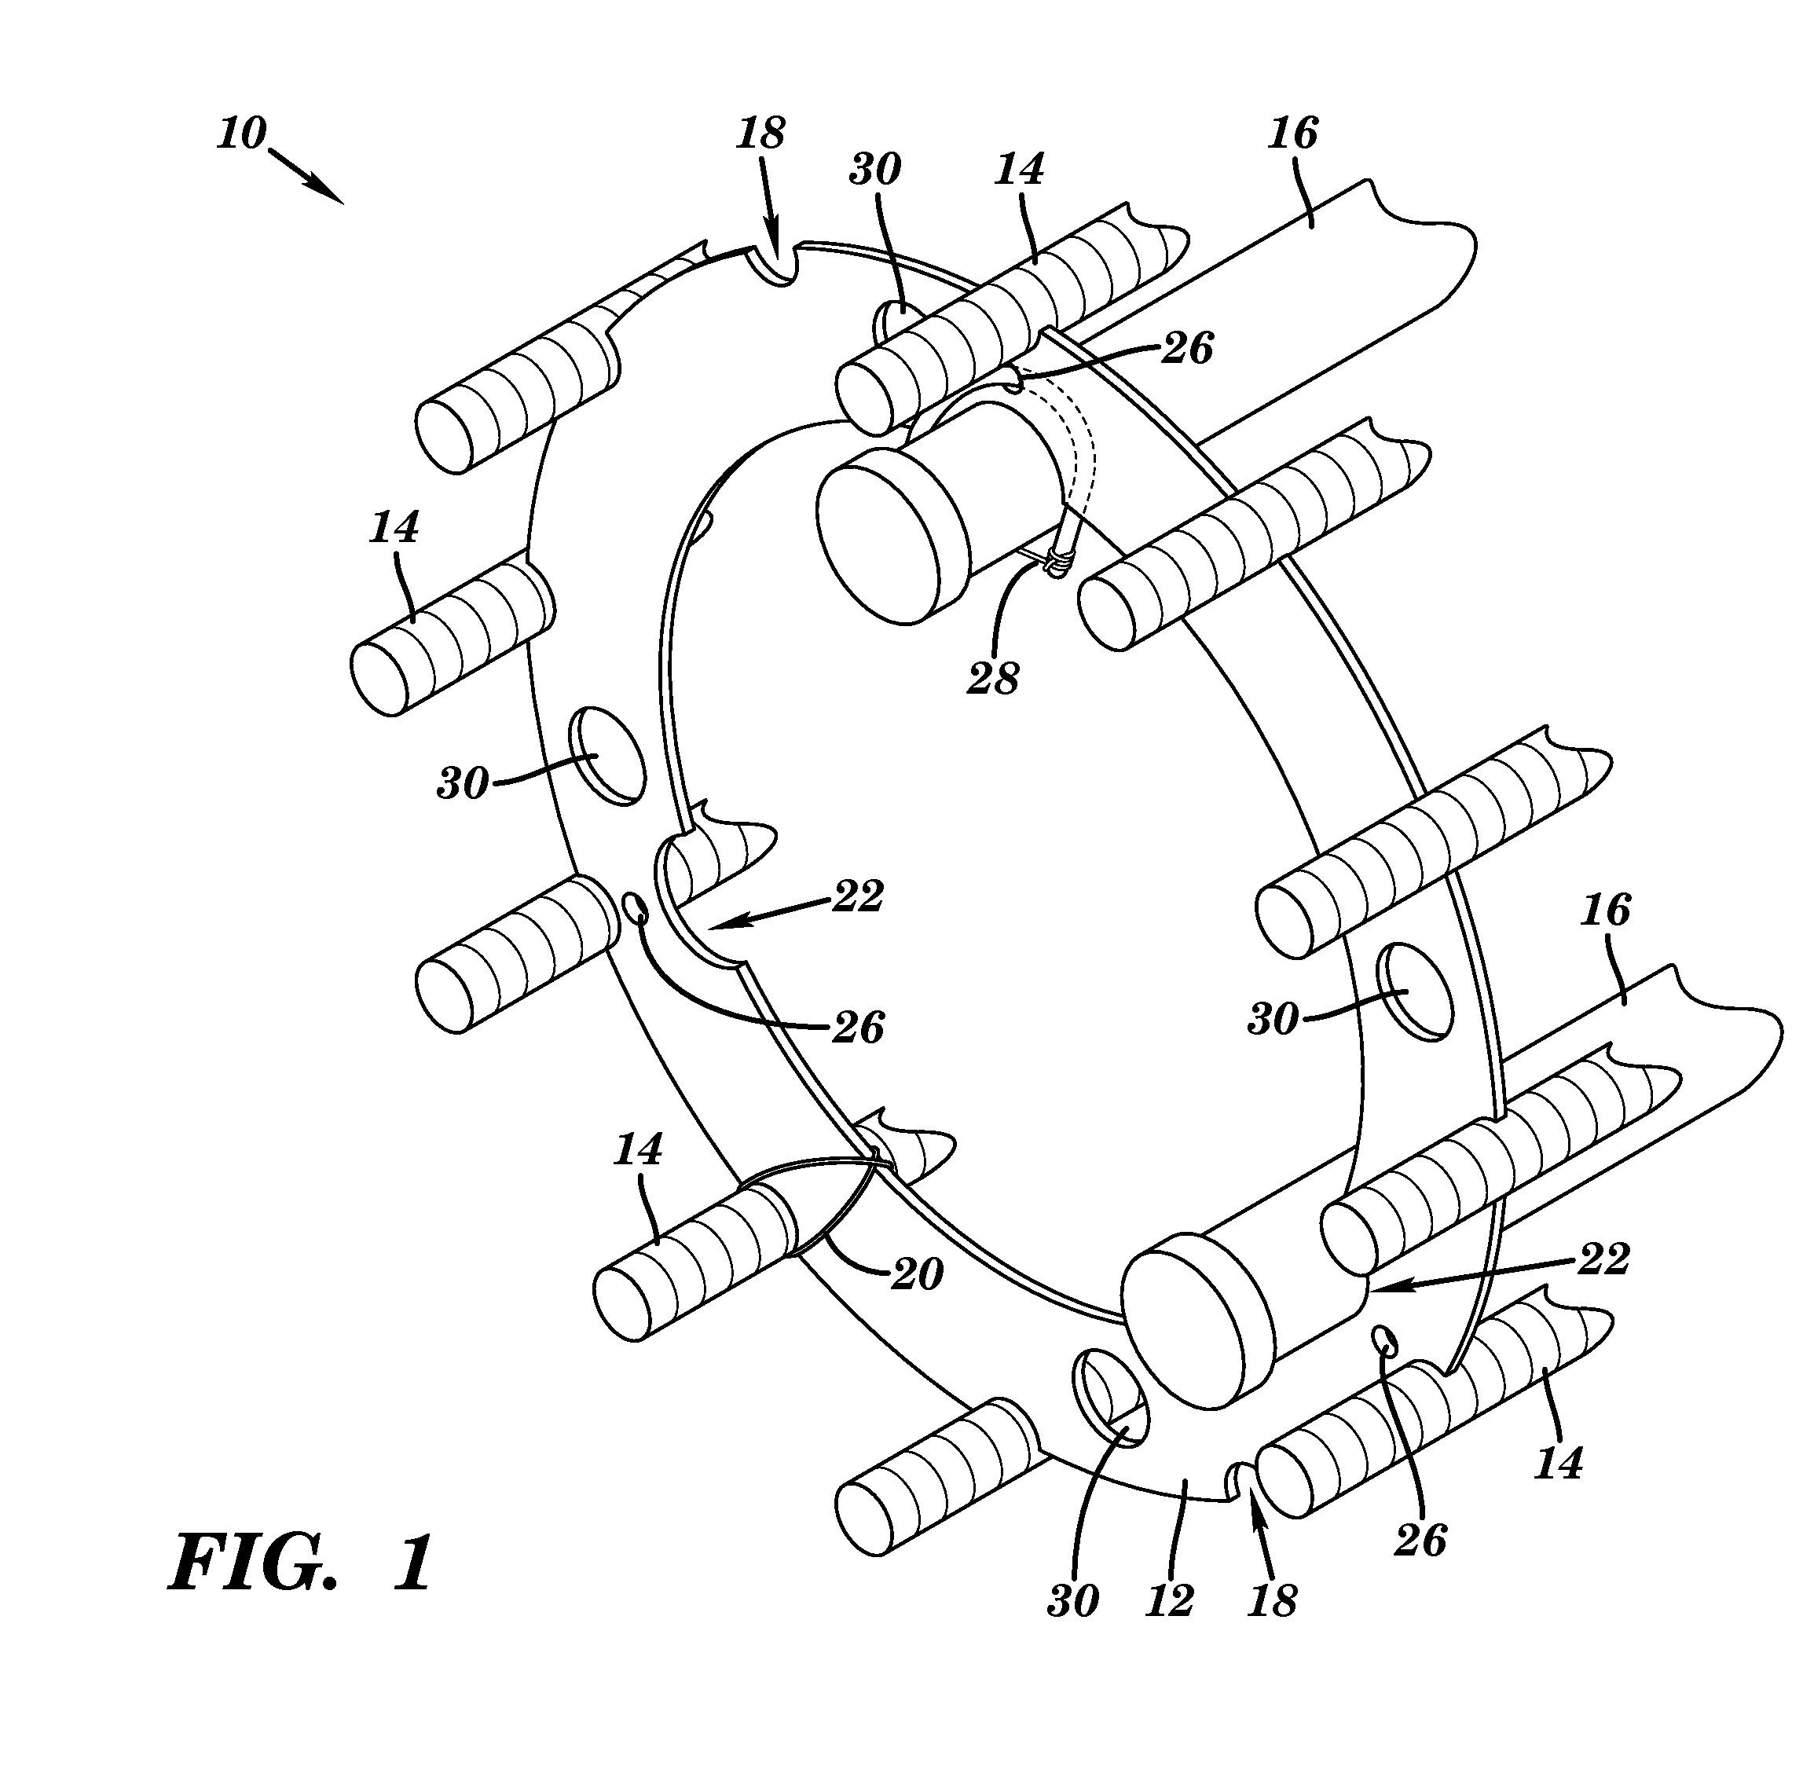
Shop Fabricated Cage-Rite© Bracing System
Courtesy Dimension Fabricators Inc
Combines a Plate Steel Hoop with Rebar X-Bracing
© Siefert Associates, LLC 2016

Slide 53
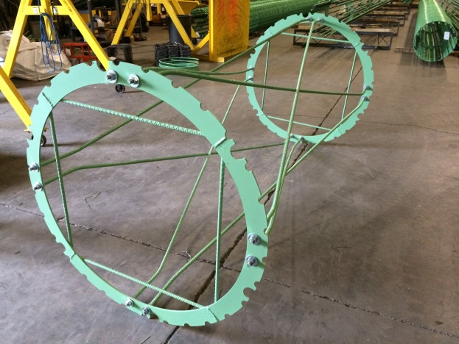
Fabricated Bracing
© Siefert Associates, LLC 2016

Slide 54
Fabricated Bracing
Plate Steel Hoops combined with Rolled Steel Angle X-Bracing
Courtesy Skanska Koch Inc - Kosciusko Bridge NYC
© Siefert Associates, LLC 2016

Slide 55
Pre-Fab Internal Bracing
Fabricated Bracing Unit - Skanska Koch Inc
© Siefert Associates, LLC 2016

Slide 56
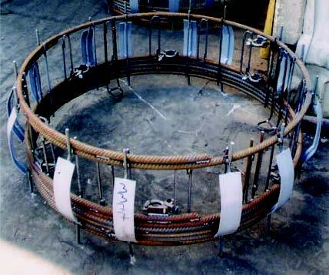
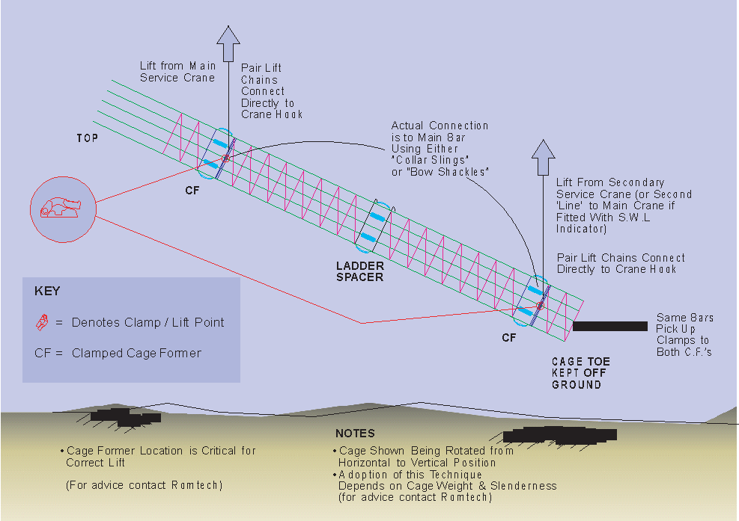
Fabricated Internal Bracing
“Ladder Spacer” Bracing System
(Substitute for X-Brace)
“Clamped Cage Former” (Hoop/Crush Ring)
Manufactured by Romtech (UK)
Engineered Upending Operation is made Possible by combining the Ladder Spacer that prevents Instability with the Cage Former which accepts the rigging points
Not available in the US
SALLC Currently researching applications
© Siefert Associates, LLC 2016

Slide 57
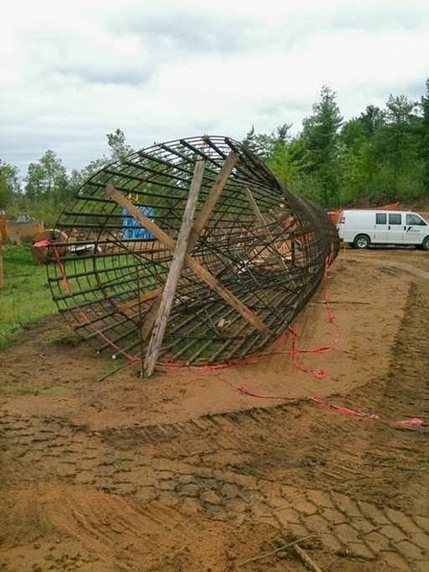
Internal Bracing Technique
Inadequate Rebar Bracing with
Supplemental Timber Bracing
Not Recommended!
Anonymous Contractor
© Siefert Associates, LLC 2016

Slide 58
Properly Braced Shaft
Upending Process
© Siefert Associates, LLC 2016

Slide 59
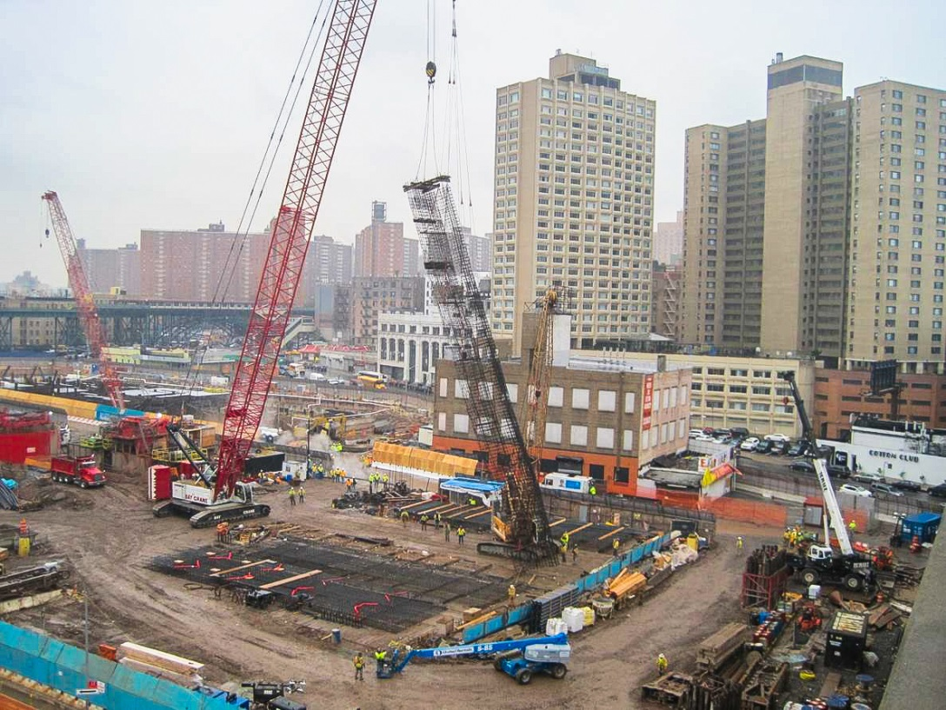
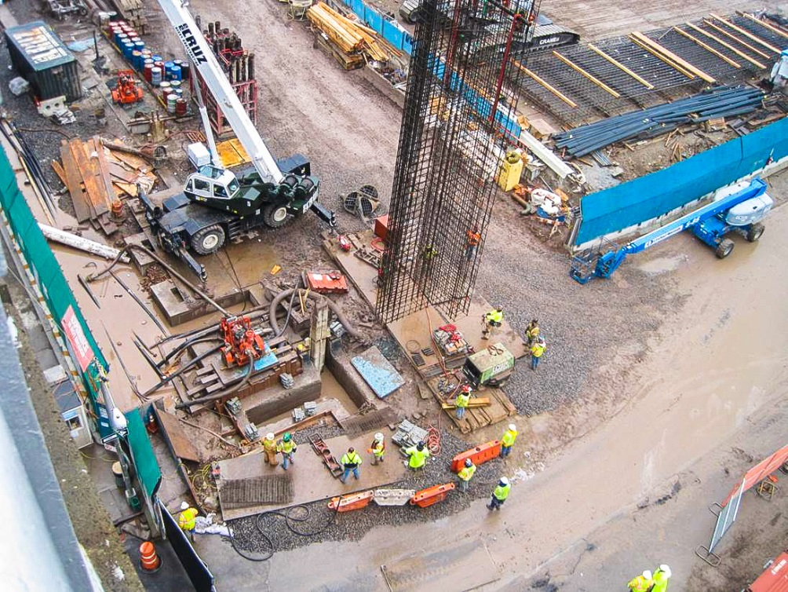
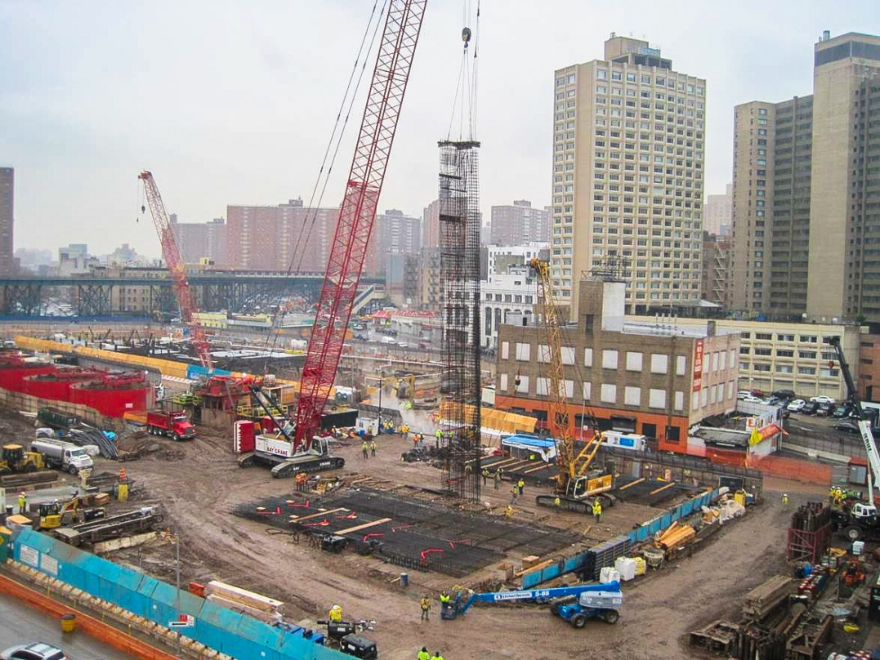
T

Slide 60
© Siefert Associates, LLC 2016

Slide 61
Current Trends in the Field etc.
Erecting Longer and Longer Cages
Determination of When to Splice & When Not to Splice
Lifting Ring, Frames / Collars
In Lieu of Pick-up Bars
U-Bolt Connections
Alternate to Tie Wire Connections
Temporary Supports for Splicing
Dealing with Embeds and Instrumentation
© Siefert Associates, LLC 2016

Slide 62
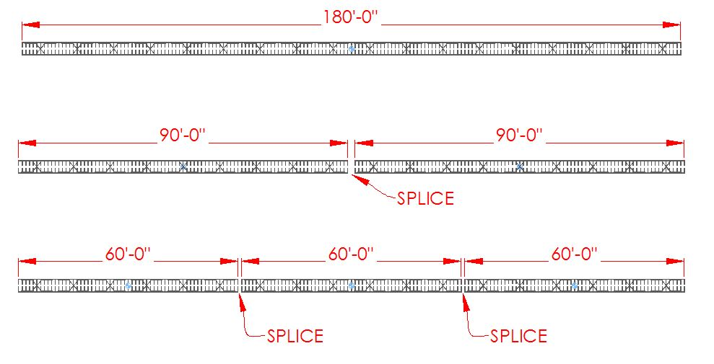
When and Where to Splice
Note: Often times weight of rebar cages is not equally distributed – Heavier near the top
© Siefert Associates, LLC 2016

Slide 63
Lift Ring or Frame/Collar
Courtesy Skanska Koch Inc
© Siefert Associates, LLC 2016

Slide 64
Lifting Frame Details
© Siefert Associates, LLC 2016

Slide 65
Lifting Frame Engineering
Full Scale Load Test
Successful Operation
© Siefert Associates, LLC 2016

Slide 66
Lifting Frame / Collar
Courtesy Skanska Koch Inc
© Siefert Associates, LLC 2016
Notes:
Fixed Videos

Slide 67
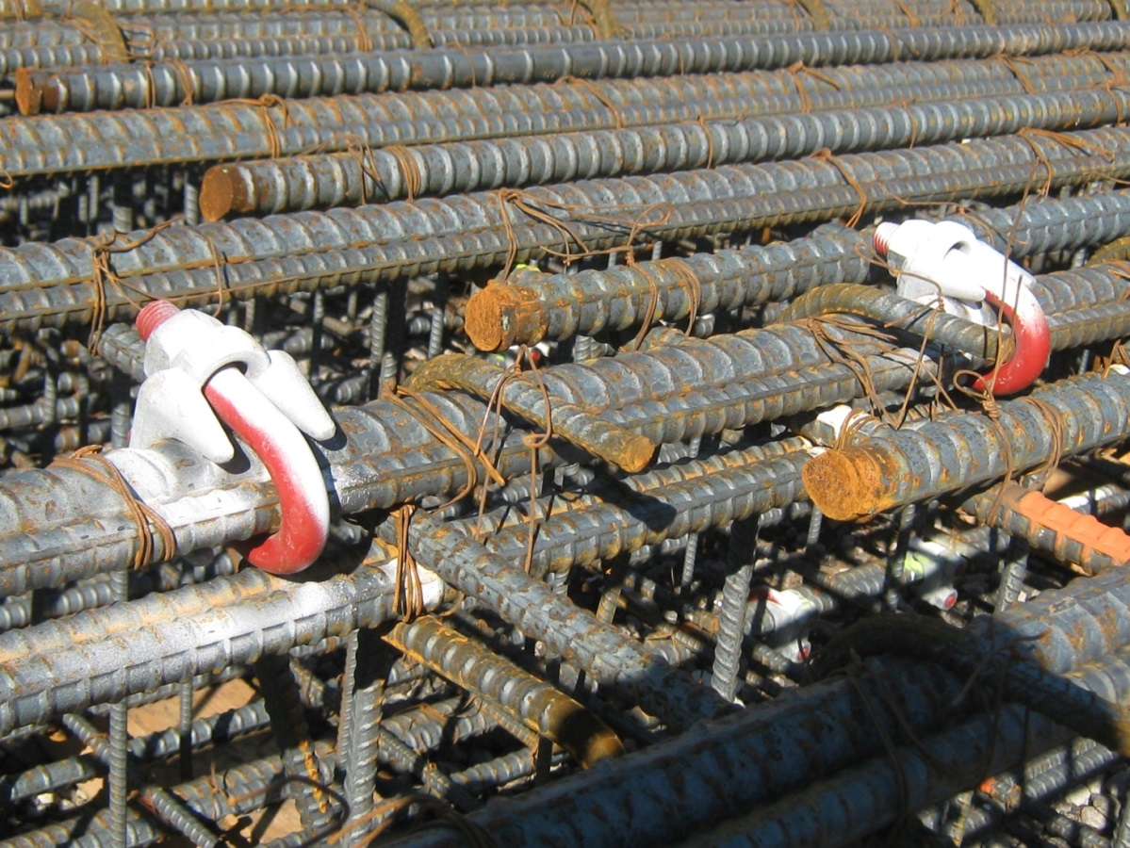
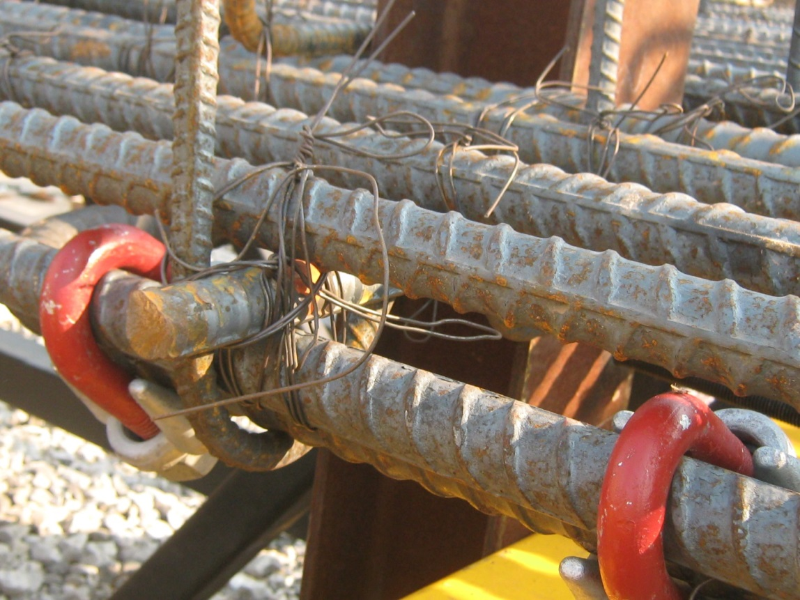
Connections
Common Practice - Crosby Clips used to Splice Pick up Bars to Longitudinal Bars
It is Imperative that testing be done for this and similar applications i.e Lifting Collar and Temporary Support Connections
Use FOS=2.0
© Siefert Associates, LLC 2016

Slide 68
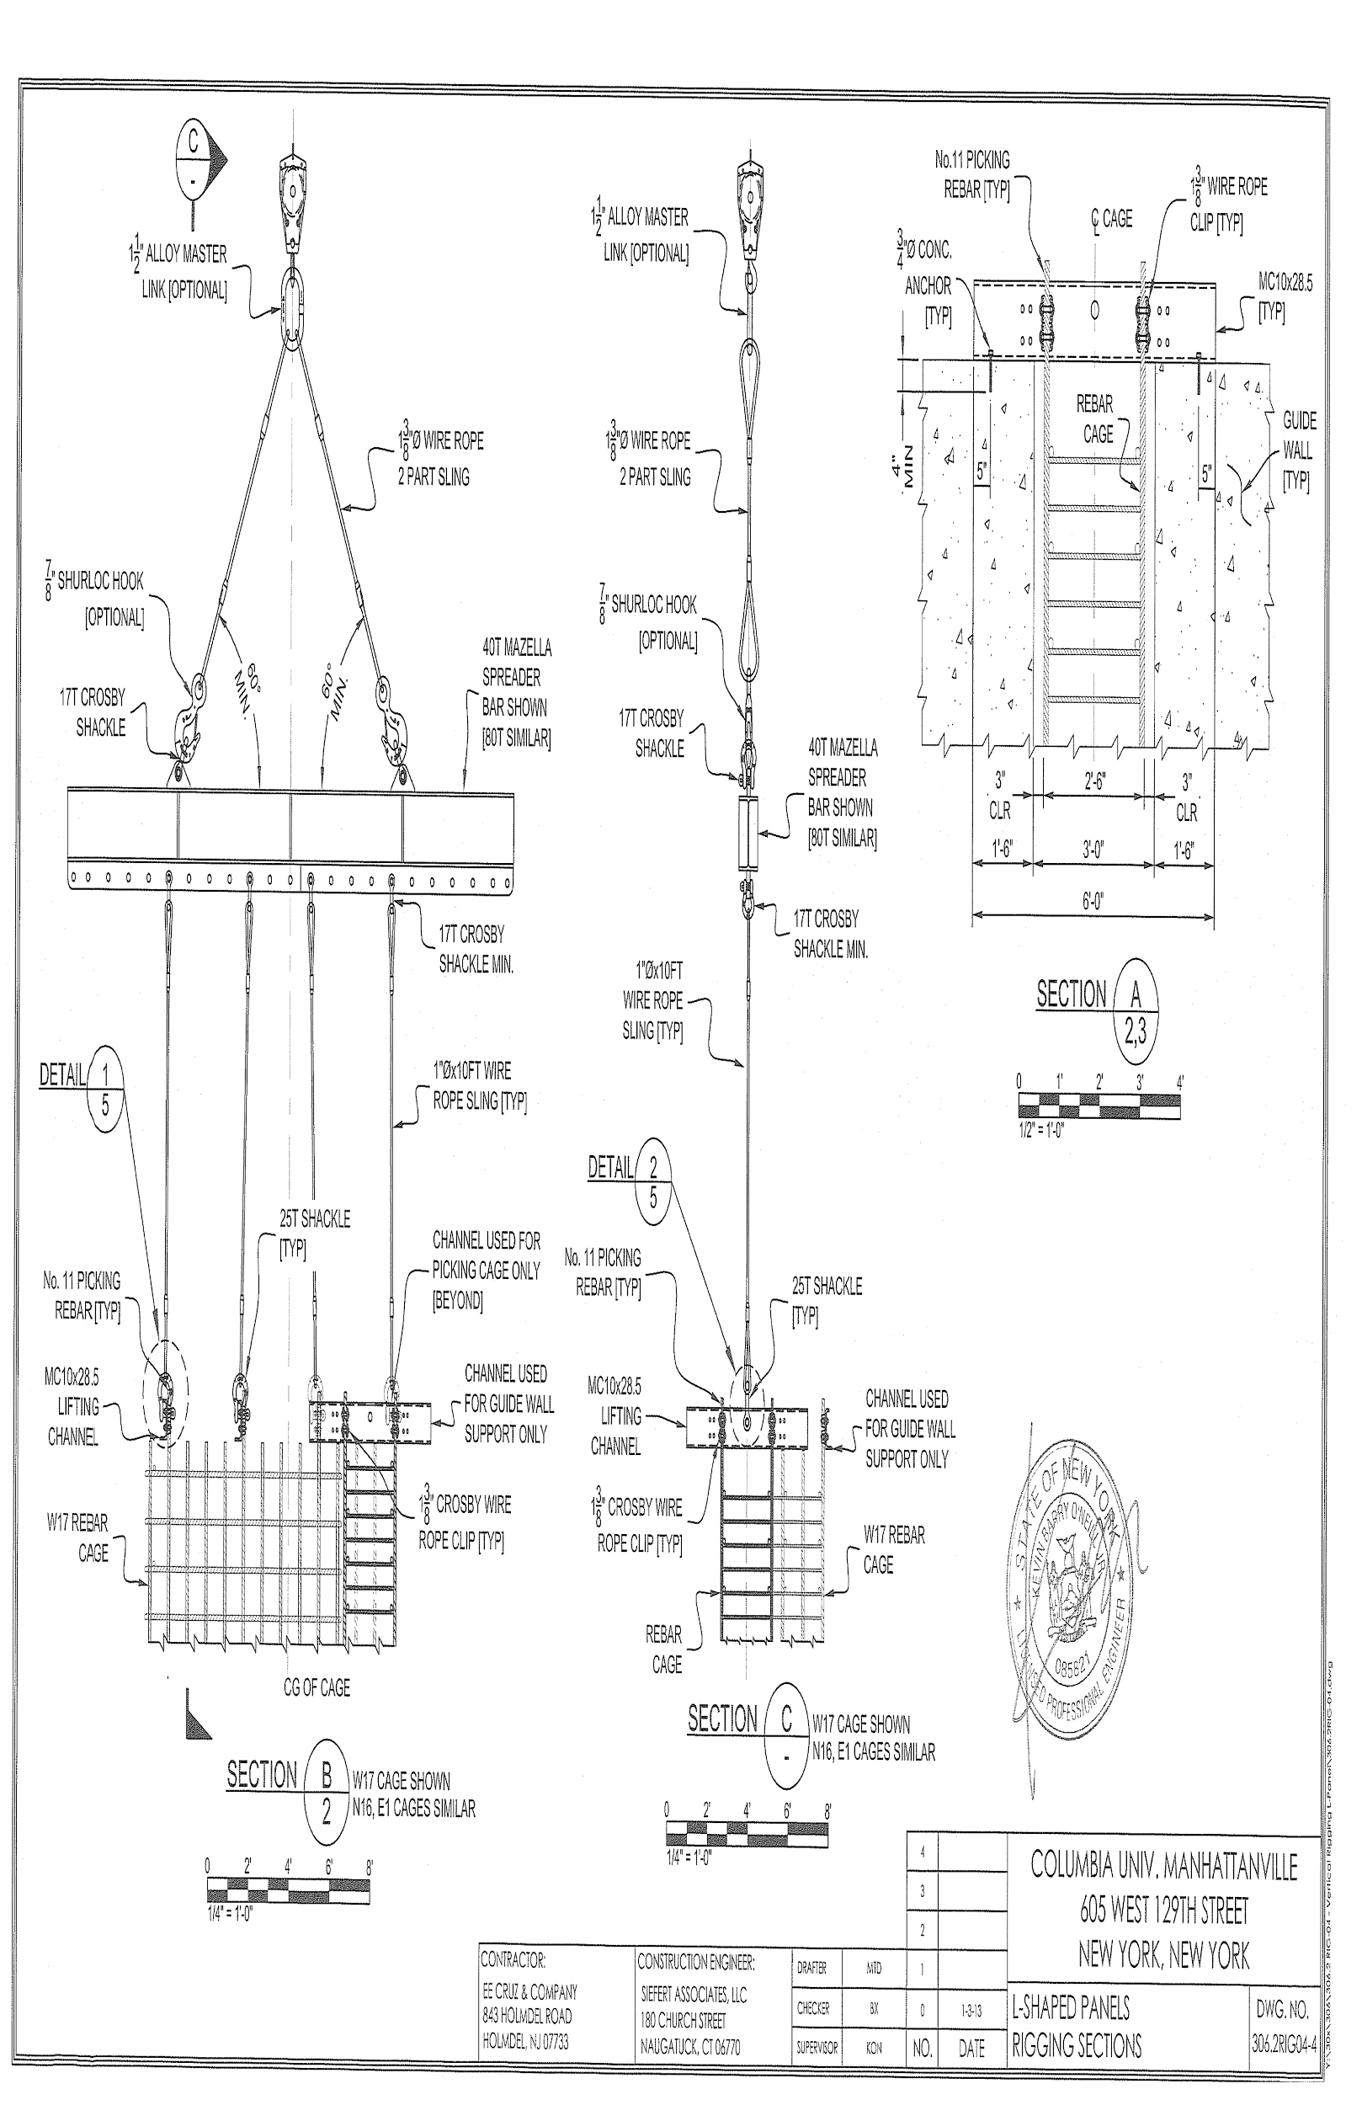
Lift Frame, Temp. Support, Connections
© Siefert Associates, LLC 2016

Slide 69
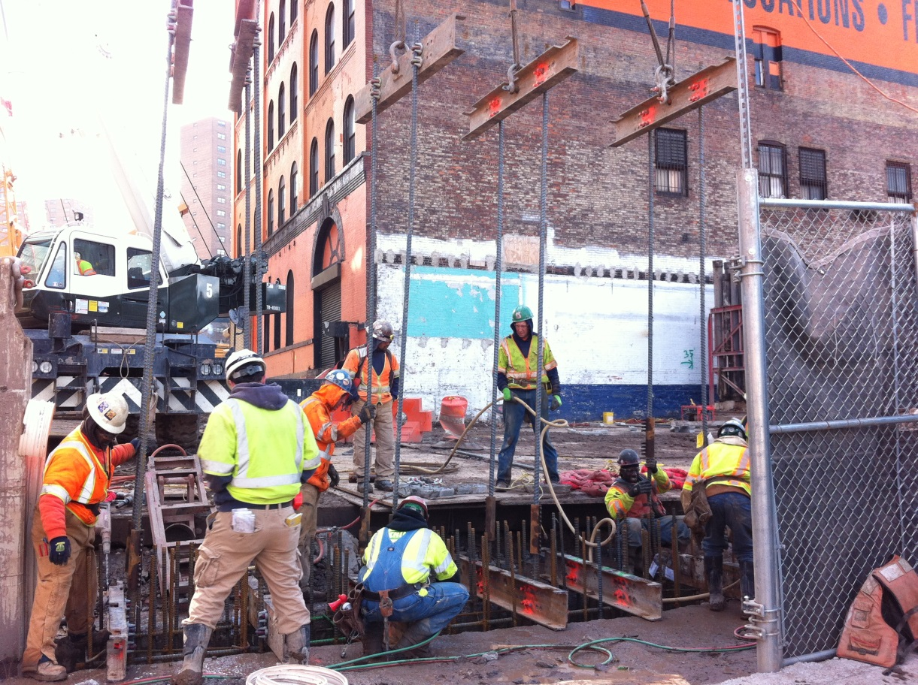
Lift Frame, Temp. Supports
Structural Steel Rolled Channels acting as Lift Frames and Temporary Supports for Erecting a Slurry Wall Cage, Connected with Crosby Clips Courtesy EE Cruz Inc
© Siefert Associates, LLC 2016

Slide 70
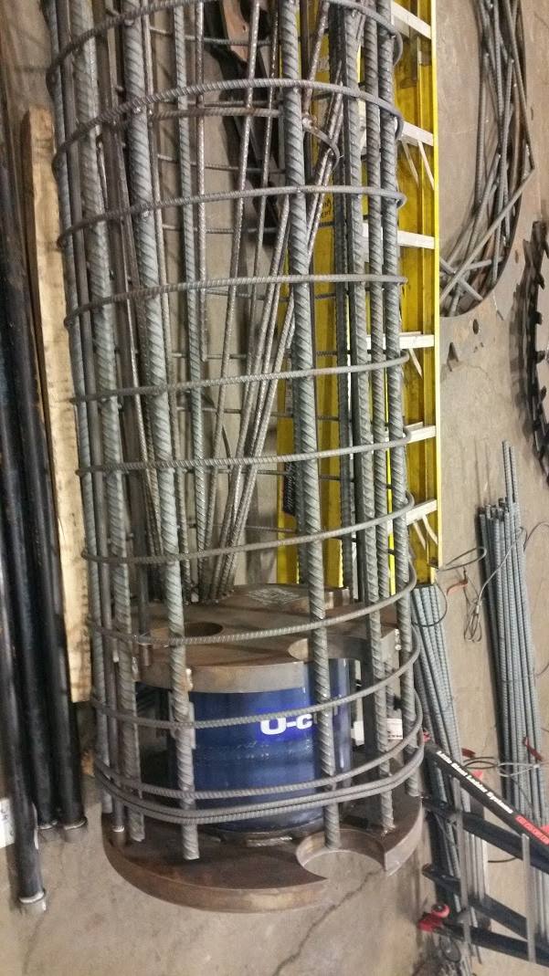
Embeds and Instrumentation
Fairly Congested Cage with Trumpets and Instrumentation
O-Cell Load Measuring Device at Bottom of Shaft with Rebar Funnel to Direct Concrete Hose Properly
© Siefert Associates, LLC 2016

Slide 71
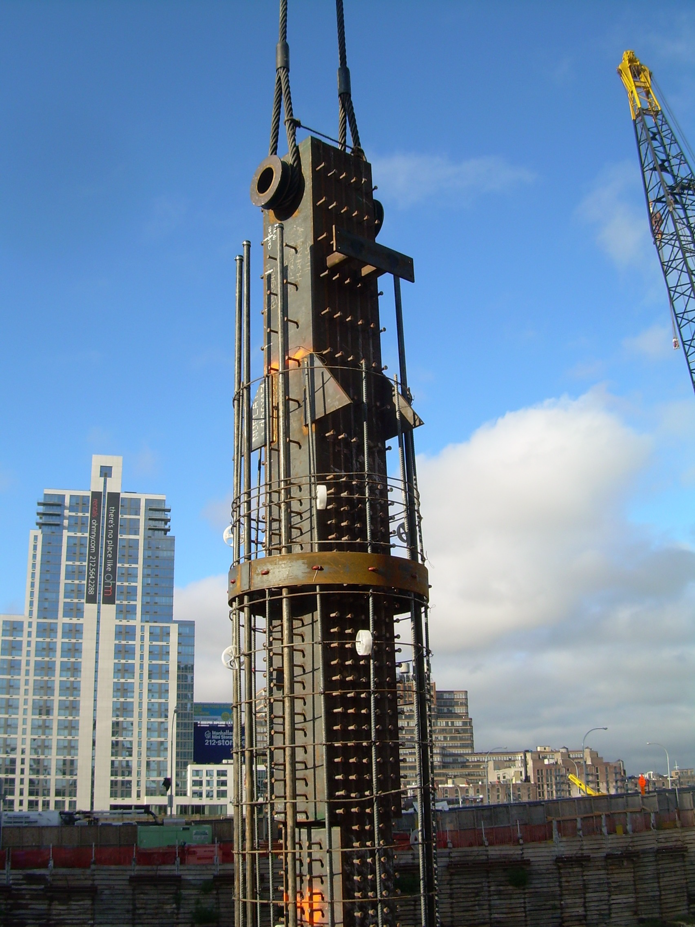
Embeds and Instrumentation
Fairly Large Embed-Solid Core Steel
24in Square !
Site J Manhattan, Yonkers Contracting Co
© Siefert Associates, LLC 2016

Slide 72
Summary of Best Practice for Permanent Design Engineers
Consider Increasing the Stiffness of The Cage
- Increase quantity and size of longitudinal bars
- Specify internal bracing be provided, min. 4-#8 bars 10ft o/c
- Allow bracing to remain in place, account for in seismic design
- Allow use of weldable rebar (A706) at contractors option; approx. 5% additional cost vs A615
Design with Constructability in Mind
- Anticipate splicing may be required when cage exceeds 60ft
- Avoid irregular rebar density-additional rebar preferred
- Avoid multiple diameters of shafts on same project
- Consider difficulty associated with embeds, blockouts and instrumentation esp. when located in same element
© Siefert Associates, LLC 2016

Slide 73
Summary of Best Practice for The Contractor
Proper Lift Planning and Safe, Cost Effective Execution
- Be prepared to utilize crane(s) with two blocks
- Consider all ramifications of cage splice locations
- Consider use of a tilt table for very long cages
- Investigate feasibility of offsite fabrication
- Share responsibilities with fabricator / erector
- Coordinate construction engineering tasks
Concrete Placement
- Plan for full encasement, esp. at embeds, blockouts and instrumentation
- Bracing best in square layout pattern
- Pour it!
© Siefert Associates, LLC 2016

Slide 74
Summary of Best Practice for The Construction Engineer
Providing for and Analyzing Structural Integrity - when the ratio of Height to Diameter exceeds 8; ie H/D > 8
- Design internal bracing, min 4-#8, with hoops 10ft o/c
- Specify tying requirements, incl. dbl. wraps and saddles
- Specify welded joints where feasible
- Calculate stiffness with estimated Beta reduction factor
- Field measure deflections to verify stiffness calc. (as a separate operation)
- Modify stiffness properties if warranted
© Siefert Associates, LLC 2016

Slide 75
Summary of Best Practice for The Construction Engineer
Engineering of Crane Plan and Rigging
- Visit site, collaborate with all parties on crane selection
- Carefully determine weight and CG for each
- Determine if lift collar or pickup bars most appropriate
- Provide reasonable number of rigging points
- Analyze horizontal, 45 degree and vertical configuration
- Consider temporary support requirements for splicing
- Use of wire rope U-bolts or sim. for conns. are very reliable
- Testing is required for conns. , lift devices, FOS=2.0
Cage Length <20 ft – 1 block, 1 point rigging
20ft < Cage Length < 40ft – 1 block, 2 point rigging
40ft < Cage Length < 140ft – 2 blocks or 2 cranes, multi pt. rigging
140ft<Cage Length - Lift Table is most appropriate
© Siefert Associates, LLC 2016

Slide 76
Summary of Best Practice for The Fabricator / Erector
Proper Prefabrication
- Template Hoops #8 min, 10ft o/c, 100% tied-wrap and saddle
- Internal bracing 4-#8 min, tied to pickup bars
- Pickup bars, 4 ea, 100% tied, double saddle tie
- No need for more than 20% of remaining joints to be tied
- Tie wire #15 min or #14 preferred; domestic sources
- Experienced ironworkers needed for critical joints
- Alternate Bracing/Hoop-Cage-Rite or structural shapes or sim.
- Alternate to pickup bars - utilize a lift collar
Rigging and Lifting
- Be prepared for deflection survey, trial and error, adjustments
- Avoid dragging on ground
© Siefert Associates, LLC 2016

Slide 77
Recommendations
Risk management practices should be implemented for rebar cage lifts consistent with site protocol for other lifts. It's unfair to rely solely on the ironworker foreman for complete responsibility of safe lifting and handling
Recognizing the importance of worker safety above all else, contractors and engineers should share their information for the good of the industry
Additional research should be performed to develop guidelines to predict stability of various cages and to broaden the scope of recommended best practices for temporary design practices –More Funding is Needed!
© Siefert Associates, LLC 2016

Slide 78
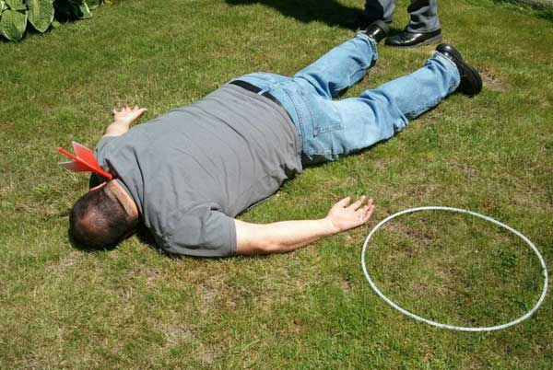
Don’t be this guy...
Unaware of Potential Serious Hazards of Seemingly Innocuous Item
© Siefert Associates, LLC 2016

Slide 79
Be this guy...
Informed and Aware of the Hazards, Prepared, and Ready to Protect
© Siefert Associates, LLC 2016

Slide 80
Reference Documents
Rebar Cage Construction and Safety, Best Practices
Michael J. Casey, Ph.D., P.E., and Girum S. Urgessa, Ph.D., P.E.
Stability of Bridge Collapse of Rebar During Construction
Ahmad M. Itani, Ph.D., S.E.
J. Camilo Builes-Mejia
Hassan Sedarat
Placing Reinforcing Bars, 9th Edition
CRSI
© Siefert Associates, LLC 2016

Slide 81
Picture Perfect Rebar Cages
Let this be your Jobsite - A Well Engineered and Executed Non-Event
© Siefert Associates, LLC 2016

