Slide 1
EXCELLENCE
Vanda Novoksonova, Biedriba Eurofortis, Latvia

Slide 2
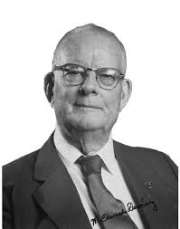
«Funny, how we don’t have time to improve, but we have plenty of time to perform work inefficiently and to resolve the same problems over and over”.
Dr. W. Edward Deming

Slide 3
1. activity - Introduction
Split in pairs/groups (for online participants in groups)
The task: find 3 things you have in common, but you can ask only 3 questions to get the answers. In order to get the answers you need your questions need to be of a high quality.
7 min.

Slide 4
2. activity – Excellent organization
Split in pairs/groups
Task: discuss components of an excellent organization. Find one for each of the letters «EXCELLENCE»
10 min.

Slide 5
2. activity – excellent organization

Slide 7
Building excellence together - Content of the course
Culture of excellence in an organization-introduction
Culture of excellence in an organization – implementation
Teamwork and organization self-assessment
Diversity management as a part of excellence culture
Stress management and personal mental health
Continuous improvement process

Slide 8
During the course you will learn:
How you can introduce excellence culture into your organization
How to use EFQM model
How does look like the teamwork in an excellence culture
How to form an assessment team in your organization
How to organize your organization self-assessment
What could be possible obstacles to take into account

Slide 9
Examples of the activities/tools
Team member self-assessment
Simple organization EFQM self-assessment
Stakeholders map and prioritization
Improvement planning
Stress relief methods
Feedback and other data analysis
and presentation

Slide 11
Anninmuizas bulv. 38-37,
Riga, Latvia
t.:+371 27763451
vanda@eurofortis.lv
www.eurofortis.lv
www.excellentorganisations.com

