Slide 1
RESILIENCE

Slide 2
WHY DO WE NEED RESILIENCE?
WHAT IS RESILIENCE?
HOW TO WORK WITH IT?
WHEN?

Slide 3
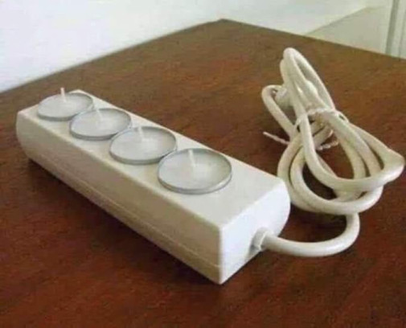
WHY DO WE NEED RESILIENCE?

Slide 4
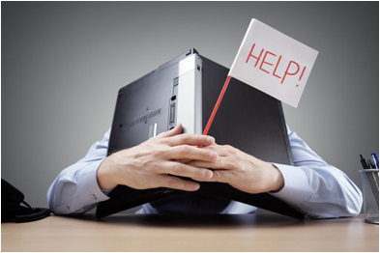
WHY DO WE NEED RESILIENCE?
20% people suffer from mental disorders
2030 – mental disorders – the main cause of disease in developed countries
250 million people in the world – burnout ( from 2022 official diagnosis)
Antidepressant consumption has increased 10-fold over the last 25 years
Every 3rd marriage is divorced
The number of civilization diseases, cancer is increasing
Impact – stress, uncertainty, conflicts, lower motivation and performance

Slide 5
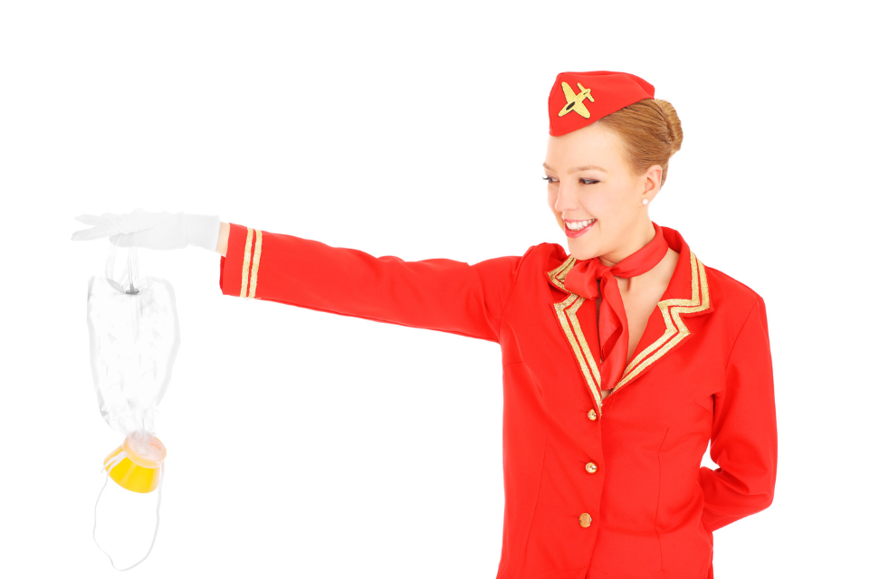
WHY DO WE NEED RESILIENCE?
We have not mastered the INTERNAL CONDITIONS - OURSELVES
Our emotions
Our mind
Our body
Our identity
TO HANDLE CRISIS SITUATIONS AND STRESS BETTER
TO INCREASE QUALITY OF LIFE AND HEALTH
That´s why we need RESILIENCE!

Slide 6
2. WHAT IS RESILIENCE?

Slide 7
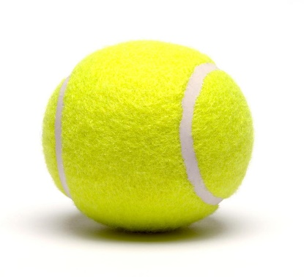
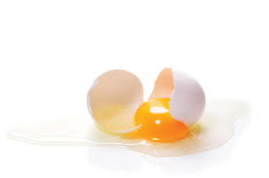
2. WHAT IS RESILIENCE?
RESILIENCE IS AN ABILITY TO MANAGE STRESS, CHANGES AND CHALLENGING LIFE SITUATIONS BETTER
40% IMPACT ON SUCCESS

Slide 8
2. WHAT IS RESILIENCE?
Research at the University of Pennsylvania + other scientific researches (1980´s)
Dr. Martin E.P. Seligman – Positive psychology
American scientists Karen Reivich and Andrew Shatté – RQ test
Competence number 1 of a person or a leader of the 21st century (Financial Times, 2001)
One of the 9 key competences in life-long learning (European Commission)

Slide 9
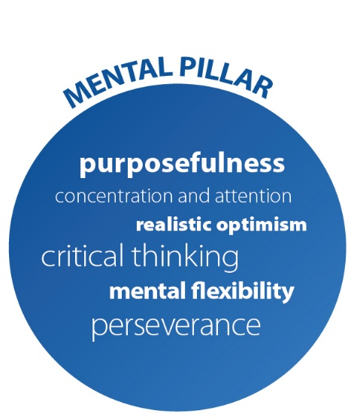
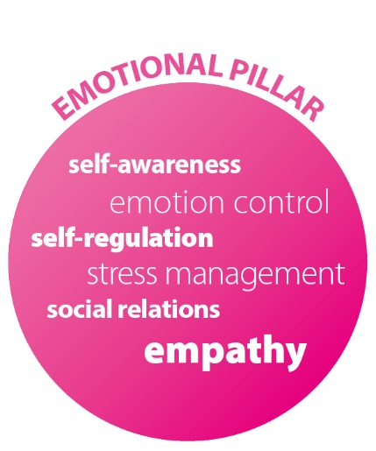
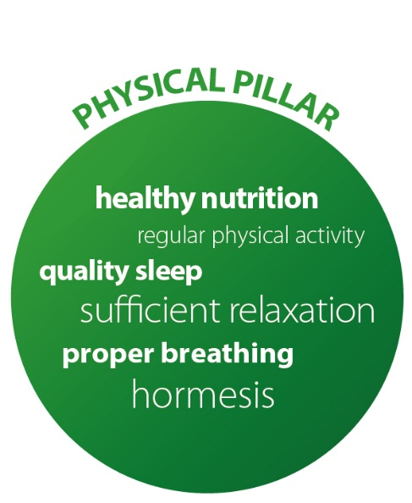
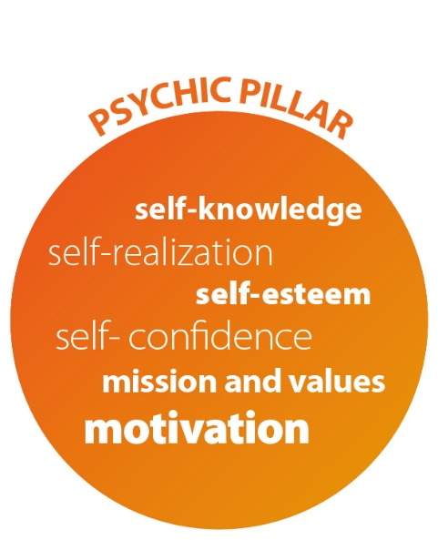
4 PILLARS OF RESILIENCE

Slide 10
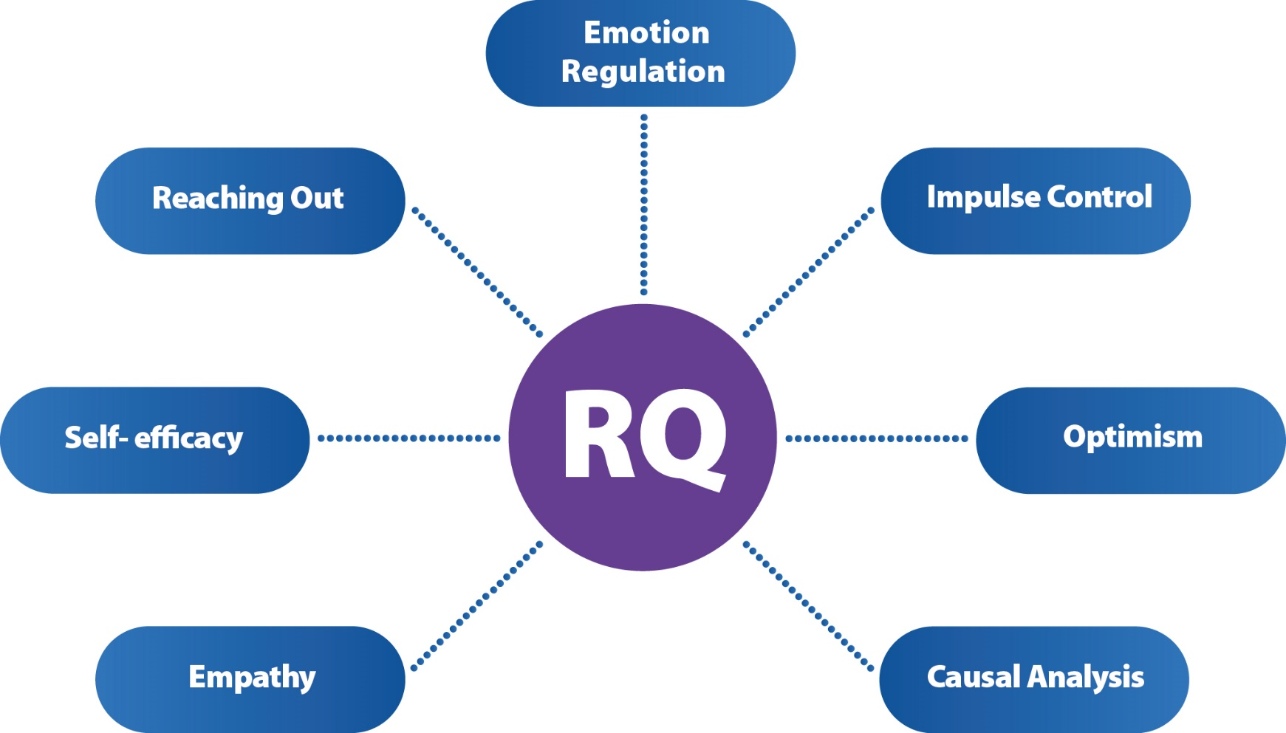
7 FACTORS OF RESILIENCE

Slide 11
3. HOW TO WORK WITH IT?
RQ

Slide 12
3. HOW TO WORK WITH IT?
Different techniques
(f.e. the radar of influence, labelling of emotions, „be happy“, positive excercise, positive effects of sleep, to increase self-knowledge, to increase self-confidence, etc.)
2. Build micro-resilient habits
3. Action plan

Slide 13
LIFE IS A MATTER OF ATTITUDE
BASIC PRINCIPLE OF RESILIENCE
IT DOESN´T MATTER WHAT HAPPENED, BUT HOW YOU RESPOND

Slide 14
HAPPINESS, HEALTH AND SUCCESS ARE NOT MATTER OF COINCIDENCE, THEY ARE MATTER OF CHOICE
But ... We have to step out of our comfort zone ☺

Slide 15
4. WHEN?

Slide 16
NOW !!!

Slide 17
THANK YOU FOR YOUR ATTENTION ☺

