Slide 1
New business model of language schools
Prof. Boris Popesko
Dr. Karel Slinták

Slide 2
Presentation structure
Introduction of the project
Research results
Business model analysis
Business model innovation

Slide 3
I. Introduction of the project

Slide 4
Changing Business Environment
Business environment is dramatically changing due to the technological development and changes in the customer´s needs
Traditional business models of many companies are becoming obsolete and needs important changes, in the ways in which they generate profit.
One of the business areas dramatically affected by the technological development, changing customer´s needs and finally by the Covid pandemic, is the area of Language schools.
Language schools, which are mostly private educational institutions, have been operating their businesses without many significant changes for most of last three decades.

Slide 5
Changing Language Education
Customers of Language Schools very often turn into alternative educational schemes, many new on-line products in the field of language education is being introduced and finally classes remained closed due to the COVID.
These facts has dramatic impact on the profitability of language schools, their revenues and finally to the simple survival.
We can observe, that traditional business schemes and models, are no longer sustainable.
Language schools are fighting for simple survival.
Due to our opinion, only solution and only way to survival is to turn to alternative business models. In other words, to find different schemes how to generate a profit, by turning to alternative products and customers.

Slide 6
The birth of the project
Motivation for the project:
The declining market of language schools
shrinking margins
loss of customers
alternatives (learning applications)
changes (market, competition, clients, technology, etc.)
Searching for hidden opportunities to innovate the business model of language schools
hidden market needs
business model transformation
new forms of teaching (covid, hybrid, online)
Possibility to fund a project from the Erasmus + program

Slide 7
Project financing and details
Erasmus+ program
Key action KA2 - Collaboration on innovation and exchange of best practices
Activity KA203 - Strategic partnerships in the field of higher education
Year of the Call: 2020
Selection round: 1
Project start: 01/10/2020
End of project: 30/09/2022
Duration of the project (number of months): 24

Slide 8
The goal of the project
Project aim
Project reflects the current changes in the business environment and aims on the development of a new business model for business school, which is based on the transformation of the product to a more value-adding form of language education which connects the language and professional education.
The key idea of the project
Such transformation allows the language school to be not only the provider of language education, but effectively connect it with professional education focused on business and personal development.

Slide 9
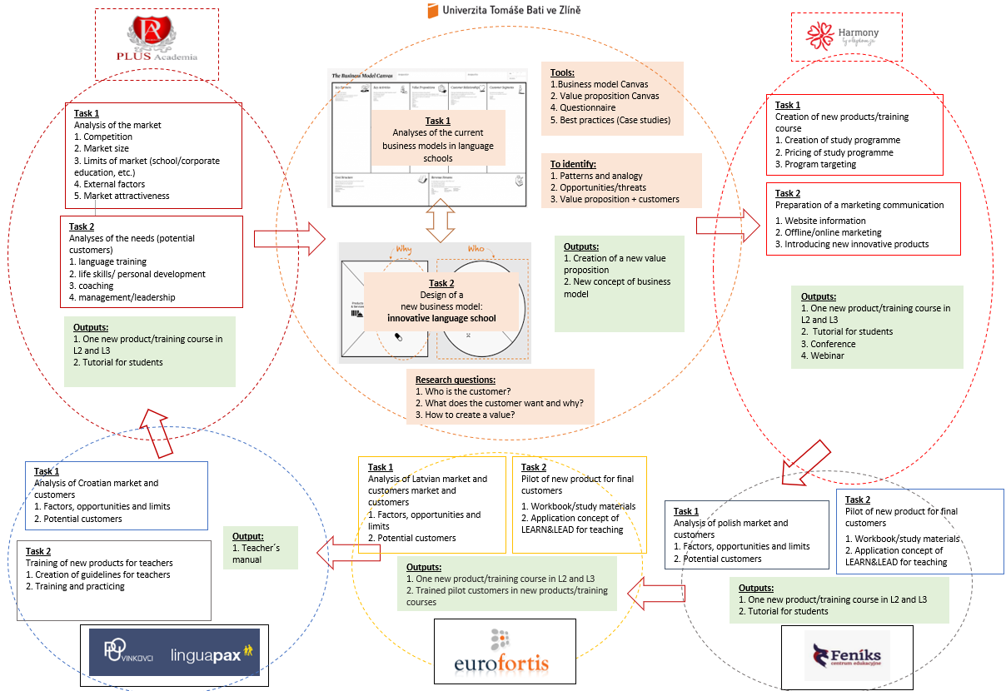
Project visualization

Slide 10
Project team
More than twenty people
Six institutions
Institution | Members of team
Tomas Bata University in Zlín | Karel Slinták
 | Boris Popesko
 | Lucie Macurová
 | Radka Daňová
 | Tomáš Urbánek
 | Marcela Červenáková
Harmony Academy | Jana Chynoradská
 | Jaro Chynoradský
 | Martin Kedro
Plus Academia | Daniel Bacík
Europejskie Centrum Językowe Summit | Pędzimąż Agnieszka
 | Katarzyna Kukla
Pucko otvoreno uciliste Vinkovci | Božanović Berislav
 | Anić Petrović Andrea
Biedrība Eurofortis | Vitkovska Adela
 | Vanda Novokšonova
 | Laura Vavilova
Partner´s name | Abbreviation | Role | Country
Tomas Bata University in Zlín | TBU/UTB | Coordinator | Czech republic
Harmony Academy | HA | Key partner | Slovakia
Plus Academia | PA | Partner | Slovakia
Centrum Edukacyjne Feniks Sp z o.o. (Europejskie Centrum Językowe Summit) | CEF (ECJS) | Partner | Poland
Pucko otvoreno uciliste Vinkovci | POUV | Partner | Croatia
Biedrība Eurofortis | BE | Partner | Latvia
And one network !

Slide 11
Project outcomes
The project had a total of six intellectual outputs defined:
IO1 - Analytical study of market and business models (UTB)
IO2 - Four new products/training courses in L2 and L3 (HA)
IO3 - The Learn&Lead Guidelines for Trainers (POUV)
IO4 - Tutorial for students (BE)
IO5 - Learn & Lead Webinar Online (HA)
IO6 - A concept of new business model (UTB)

Slide 12
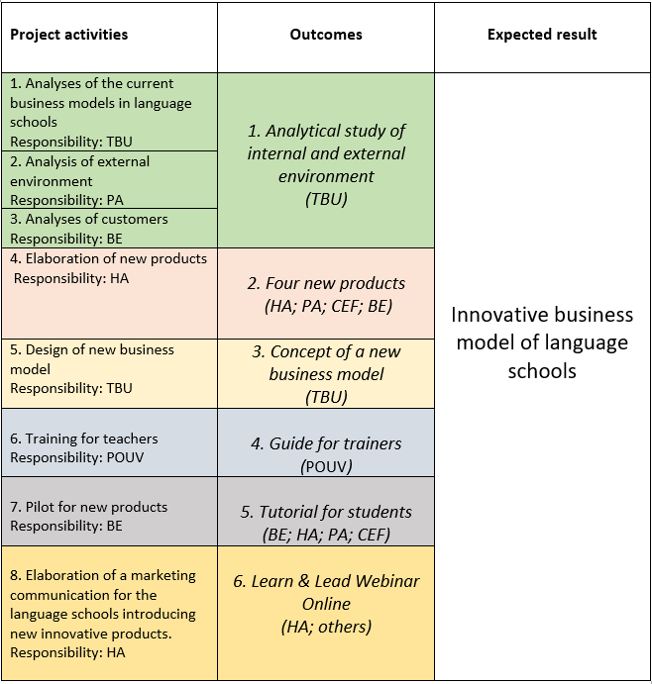
Workflow
A total of eight project activities
Six intellectual outputs
One key goal

Slide 13
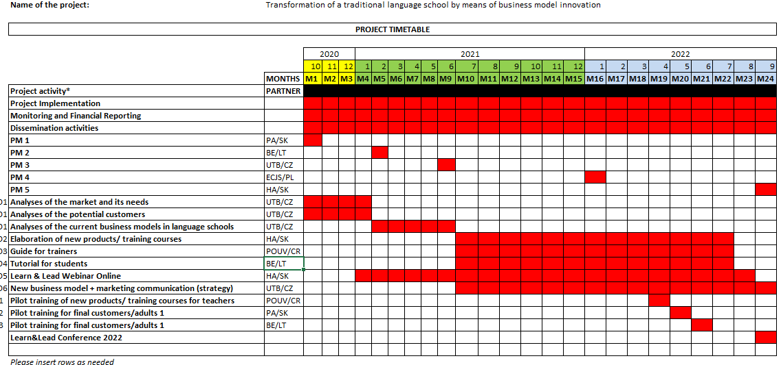
Project timetable

Slide 14
Transnational project meetings
The project included five project meetings. In the end, six meetings took place, and due to the disruption of the original schedule by covid (the first two meetings were online, the others in person):
Kick-off meeting (11/2020) – IO1 Market analysis (online; Slovakia: PA)
Meeting (3/2021) – IO1 Market analysis (online; Latvia: BE)
Meeting (8/2021) – IO1 Business model analysis (Czechia: UTB)
Meeting (10/2021) – IO2 New products+ IO6 Business model Innovation (Latvia: BE)
Meeting (1/2022) – IO2 New products + IO6 New business model (Poland: Edufeniks)
Meeting (9/2022) – Summary of the project (Slovakia: HA)
We actually met fortnightly online for the last year of the project. More than 100 meetings (online) took place during the project.

Slide 15
Learning, Teaching, Training Activities
The project partners also held meetings related to teacher training and course piloting (three meetings) and one conference event:
C1 TRAINING FOR TRAINERS (3/2022) – IO3 training courses for teachers (Croatia; POUV)
C2 Pilot trainings (5/2022) – IO2 Testing four new products on clients (Slovakia: PA)
C3 Pilot trainings (6/2022) – IO2 Testing four new products on clients (Latvia: BE)
Conference (9/2022) – Summary of the project and presenting the results

Slide 16
II. Research results

Slide 17
Research activities
The analysis of the business model of language schools was based on three types of research:
Exploratory research – analysis of the offer of language schools in the Czech Republic (80 schools)
Questionnaire survey (Q1) – analysis of the business model of language schools (respondent: manager of language schools)
Questionnaire survey (Q2) – analysis of language school customer preferences (respondent: language school client)

Slide 18
Research I: Offer of language schools
The aim of the research: to map the range of services/products of language schools
Research implementation: 2021
Research location: Czechia
Sample: 80 language schools

Slide 19
Research I: Offer of language schools
Top four products
Courses for the public
Company courses
Private lessons
Courses for children
Research findings:
Wide range of services
21 products in the offer of language schools
Most schools do not offer 11 or more products
General market segmentation
The most offered course is a course for the public
Discussion clubs are underrated
The range of products is determined by the size of the market
Language schools do not focus much on areas outside of education (such as translation and interpreting)
Bottom four products
Courses for mothers
Courses for the unemployed
Discussion clubs
Courses for seniors

Slide 20
Research II: BM of LANGUAGE SCHOOLS
The aim of the research: Analyse the business model of language schools
Type of research: questionnaire survey (Q1)
Sample size = 112 respondents
Localization of research = five EU countries (Czechia, Slovakia, Latvia, Croatia, Poland)
Research implementation = 2021
Where do we want to teach…?
Classrooms
Online
Companies (office, training center etc.)
How do we want to teach … ?
Course
Conversations
Private lessons
What do we want to teach …?
Only foreign language
Language + business/Exam preparation (graduation)
Personal development

Slide 21
Research II: BM of LANGUAGE SCHOOLS
Research findings:
1. Language schools do not focus too much on corporate clients.
2. Language schools do not offer teaching in an informal environment (café, park, camp)
3. Most schools do not only teach a foreign language (teaching in conjunction with the development of other soft skills).
4. Most language schools do not offer teaching in an alternative way (i.e. mobility, discussion, camp etc.).
5. Most schools allow clients to co-create courses.
6. Most schools do not form study groups of 5-8 students.
Hypotheses | p-value | Results
H1: At least a third of language schools focus on corporate clients | p > 0.05 | Rejected
H2: At least a third of schools offer teaching in an informal environment (i.e. park, café, camps) | p > 0.05 | Rejected
H3: Most schools only teach a foreign language without a professional context (in the sense of foreign language + management, foreign language + personal develop-ment, etc.) | p > 0.05 | Rejected
H4: Most language schools do not offer teaching in an alternative way (i.e. mobility+discussion club + camp + tourism) | p < 0.05 | Accepted
H5: Most schools do not allow clients to co-create the learning process | p > 0.05 | Rejected
H6: Most schools offer courses for 5-8 students | p > 0.05 | Rejected

Slide 22
Research III: Customer preferences
The aim of the research: Analyse the requirements, needs and expectations of language school clients
Type of research: questionnaire survey (Q2)
Sample size = 421 respondents
Localization of research = five EU countries (Czechia, Slovakia, Latvia, Croatia, Poland)
Research implementation = 2021
What are our barriers…?
Lack of time
Concerns (feeling embarrassed)
Boring lecture
What do we want?
Conversation
Course (classic form of study ! )
Private lesson (individual approach)
What is (y)our expectation…?
Develop ourselves
Meet new people

Slide 23
Research III: Customer preferences
Research findings:
Most of the clients are not „students“ (i.e. children, youth, university students).
Most of the clients are not stimulated to learn by staying abroad.
The majority of clients do not prefer teaching based on classic courses and are looking for alternatives in the form of conversations, private lessons, mobility.
Most of the clients want to learn 1-2 times a week.
Most clients prefer face-to-face teaching (not online).
Most clients do not want to learn only a foreign language (personal development is important ! ).
Hypotheses | p-value | Results
H1: Most of the clients of language schools are students (i.e. more than 50 % of all clients) | p > 0.05 | Rejected
H2: Most clients are stimulated to learn by an educational stay abroad. | p > 0.05 | Rejected
H3: The majority of clients prefer classic courses (i.e. more than 50 % of all respondents). | p > 0.05 | Rejected
H4: Most clients prefer lessons 1-2 times a week | p < 0.05 | Accepted
H5: Most clients prefer face-to-face teaching (i.e. more than 50 % of respondents) | p < 0.05 | Accepted
H6: Most clients prefer language teaching without a professional context (i.e. more than 50 % of respondents) | p > 0.05 | Rejected

Slide 24
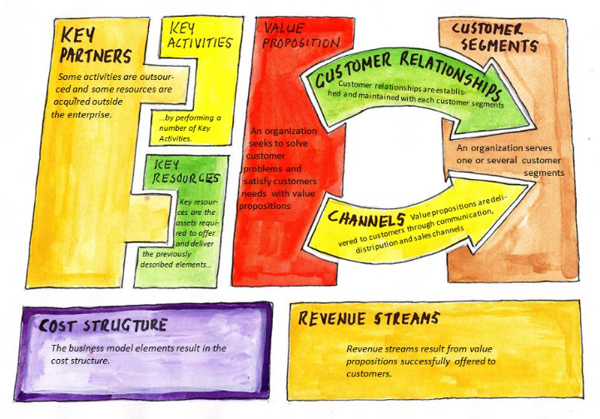
III. Business model analysis

Slide 25
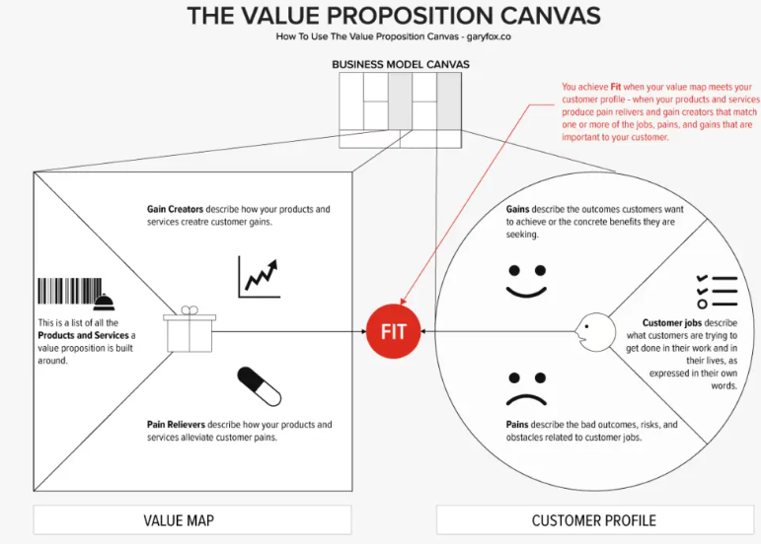
Source: Osterwalder, A., Pigneur, Y., Bernarda, G., & Smith, A. (2015).

Slide 26
Consumer vs. producer perspectives
Category | The consumer's view (clients) | A producer's view (Language school)
Who is customer? | Adults (41 %) (Self-payer) | Children and youth (56 %) (Parents pay course)
How to learn/teach? | Conversation (60 %) Course (53 %) | Classical course (95 %) Conversation (92 %)
What to learn/teach? | Foreign language (59 %) Personal development (44 %) Business/management (29 %) | Foreign language (100 %) Business/management (55 %) Personal development (46 %)

Slide 27
Consumer vs. producer perspectives
Category | The consumer's view (clients) | A producer's view (Language school)
Where to learn/teach? | Non-formal environment (57 %) Stay abroad (32 %) Online (25 %) | Classroom (93 %) Online (89 %) Company (62 %)
How often to learn/teach? | Weekly course (65 %) | Annual course (66 %)
What activities to use to learn/teach? | Movies (83 %) Music (72 %) | Textbooks (97 %) YouTube videos (92 %)

Slide 28
Hidden opportunities behind the VPC model
Subject of research | Consumer vs. Provider | Opportunity for BMI
Customer identification | Mismatch | Adults Corporate clientele
Method of teaching | Mismatch | Conversation Private lesson
Teaching content | Fit | Personal development
Place of teaching | Mismatch | Non-formal environment
Teaching period | Mismatch | 1-2 per week
Teaching aids | Mismatch | Movies Music
Teaching approach | Fit | Learning through play

Slide 29
Current business model of language schools
The core of the model consists of three types of value propositions:
A. Corporate courses
B. Courses for the public
C. Courses for children and youth
Most language schools view the market from the perspective of these three segments:
A. Corporate clientele (the most lucrative part of the market)
B. Public (self-payers)
Students (children are users; parents are customers)
General profile of a language school: (1) provider of language education without professional context; (2) teaching in classrooms and with books; (3) teacher as lesson replicators.

Slide 30
Current business model of language schools
Key partners | Key activities | Value proposition |  | Customer Relationships | Customer Segments
 | Key sources |  |  | Channels
Cost structure |  |  | Revenue Streams
Course development
Personal management (Recruitment of quality lecturers)
Marketing
Offer of courses (web, press, fb)
Newsletters
Individual support
Lecturers / native speakers
Language book publishers
Association of Language School
Language education for companies
Language education for public
Language education for young people
Corporate clients
Public (Individuals)
Young people (pupil, students)
Classrooms
(it, facilities, etc.)
Brand of School
Client network
Tribal employees
Web
Facebook
Email
Conferences
Salaries for lectures (9 euro/hour)
Teaching materials
Training for teachers/lectures
Advertisement
Facilities/energy/rent
Course fee (18 euro/hour)
Other revenues (proofreading, translations, mobility, individual lessons, etc.)

Slide 31
IV. Business model innovation

Slide 32
Opportunities and trends
Change market perception: the transition from children to adults and corporate customers and from a unified market to a customized market
Changing teaching methods: A trend related to the direct teaching method and learning through play.
Change the content focus of lessons: Transition from the development of language skills to the development of a person.
Change the spatio-temporal perspective of teaching: Transition from a formal school environment to an informal environment.
Changing the core business of the language school: A shift away from language education providers to educational platform creators.
Limits of the current BM of language schools
Offer of language schools | Strategy | Customer segments
Courses for the public | Standardization | Adults
Courses for students | Standardization | Students
Corporate courses | Customized / specialization | Companies

Slide 33
Changes in the BM of language schools
Category | Current business model of language schools | Innovative business model of language schools
Customers | Public Children and youth Business clients | Individuals Business clients Lectures Universities and other educational institution
Value proposition | Course for public Course for students Course for companies | Language education (only) Language in context of personal development Monetization of lecturers' knowledge
Key competencies | School infrastructure Brand of School | Educational platform
Economic model | Course fee | Medation fee

Slide 34
New business model
New challenges for BM:
To transform language schools into institutions creating a knowledge platform
To redefine customers: typical customers of language schools were students, the public and corporate clients.
To change the value proposition: not only a foreign language, but also personal development
To create a new economic model: education mediation fees

Slide 35
New business model
New customer segments :
New value propositions:
1. Individuals (students, public)
2. Business clients (language + personal development + leadership)
3. Lecturers (teachers, trainers, coaches)
4. Educational institutions (for example, universities, secondary vocational schools etc.)
1. To teach individuals to communicate in a foreign language (only language education),
2. To teach individuals in companies the language in the context of personal development,
3. Monetize lecturers' knowledge,
4. Monetize the courses of educational institutions.

Slide 36
Creator of educational platform
Different preferences
Students
No market, but the existence of knowledge
Educational institution
Private trainers
Course replicators,
unequal conditions
Solution: creation of a knowledge platform

Slide 37
BMI of language schools (new business model)
Key partners | Key activities | Value Proposition |  | Customer Relationships | Customer Segments
 | Key sources |  |  | Channels
Cost structure |  |  | Revenue Streams
Platform development
Networking
Regular offer of courses
Call (centrum)
Newsletter
Lecturers / native speakers
Language schools
Educational institution
VP1: Language education
VP2: Foreign language in the context of personal development
VP3: Opening up new
markets
VP4: Market visibility of the courses
Individuals
Business clients
Lectures (from network)
Educational institution
Platform/network
Teaching and leadership (methods and philosophy)
Webinar
FB
Conference
Apps
Platform development costs
Staff salary
Advertising
Course fee (18 euro/hour)
Mediation fee ( Access to the educational platform)

Slide 38
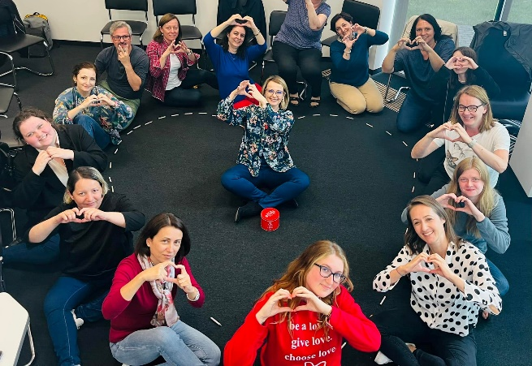
Smart MANAGEREVOLUTION
Building Excellence Culture Together
Empowering People at Work
Resilience

Slide 39
From product innovation to business model innovation
New products created as part of the project activity are part of value proposition 2 (VP2 ).
The creation of new products enabled the transformation of the business model of language schools:
Product innovation led to core business model Innovation (new value proposition and redefinition of BM)
The transformation of the product into a higher value-added language teaching that combines language learning with the development of soft skills and team.
An example of new products, supporting the innovation of the business model of language schools in area of personal development, are:
Product 1 - Resilience
Product 2 - SMART MANAGEREVOLUTION
Product 3 - Building Excellence Culture Together
Product 4 - Empowering People at Work

Slide 40
Specifications of the new business model
New elements of business model
Educational platforms: the innovation of the business model of language schools is similar to successful business models that have established themselves in the field of e-learning applications and online learning platforms.
A hybrid form of teaching (personal + online), which is based on providing a suitable course to a specific customer segment.
Intermediary fees: The economic model of the innovative business model therefore calculates not only course fees, but also intermediary fees (i.e. the fee for entering the knowledge platform, which will range from 15-30 % of the unit price of the course).
Education intermediary: monetize the knowledge not only of individuals (lecturers), but also of institutions (universities) under the premise of creating a functional knowledge platform that will be strongly connected to selected market segments.

Slide 41
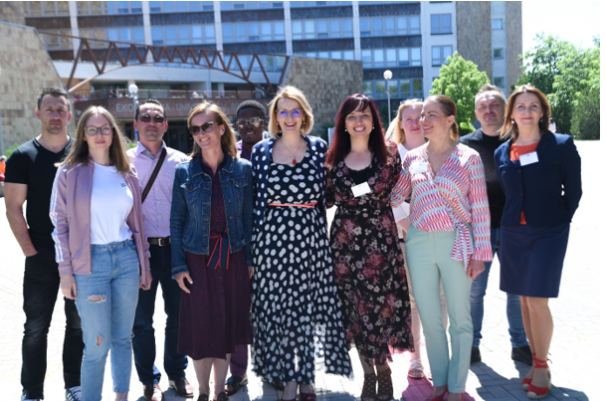
Thank you for your attention

